Slide 1

Lecture 5 Analysis of epidemic time-series part 2: biases in the observation process
Lecturer: Freya Shearer

Slide 2
What is observed?
In the last lecture we described how to quantify trends in a time series of infections
The underlying time series of infections are often not known
Infections are not directly observable
Instead, surveillance systems monitor other downstream quantities:
Cases
Hospitalisations
Deaths
Viral concentration in wastewater
The test-positive proportion (more on this in lecture 6)
We observe these quantities as we might expect them to correlate with, and be proportional to the infection time series

Slide 3
Features that arise from surveillance systems
Time series data collected through infectious disease surveillance systems are imperfect due to, for example:
Noise
Reporting delays
Delays to measurable outcomes
Day-of-the-week effects
Truncation
Censoring
Missing data
Changes in behaviour (e.g. testing, test-seeking, healthcare-seeking) (more on this in lecture 6)
Notes:
Censoring
Left-censored – The event of interest occurred before the start of observation, but the exact time is unknown.
Right-censored – The event of interest occurred after the last observation period or outside the study.
Interval censored – You only know that the event occurred within a certain time interval.
Right truncation – Subjects or data points above a certain threshold are excluded. E.g. When we shift case notifications back to date of symptom onset, we’ve excluded an unknown number of cases who developed symptoms on certain days but have not yet been reported (and eventually will be).

Slide 4
This lecture’s scope
In this lecture we will:
Describe common data problems arising from the observation processes of surveillance systems
The focus will be on noise and delays
Provide an overview of the methods that exist for accounting for these data problems
You will gain experience implementing these methods in this afternoon’s practical
Emphasise the importance of maintaining data integrity so that such methods can be used
We will expand on other biases in surveillance systems in lecture 6

Slide 5
Noise in epidemic time series

Slide 6
Sources of noise
There can be many sources of noise or uncertainty in observation processes, e.g.
Fundamental noise
Day-of-the-week effects
Reporting errors
Missing periods of data
Missing fields of data
Statistical methods can handle noise appropriately
As epidemiologists, it is important to:
Recognise sources of noise
Employ statistical methods for dealing with noise (where possible)
Understand biases that may be present if unable to account for a source of noise
Data integrity is crucial for minimising noise and uncertainty, and allowing appropriate statistical methods to be employed

Slide 7
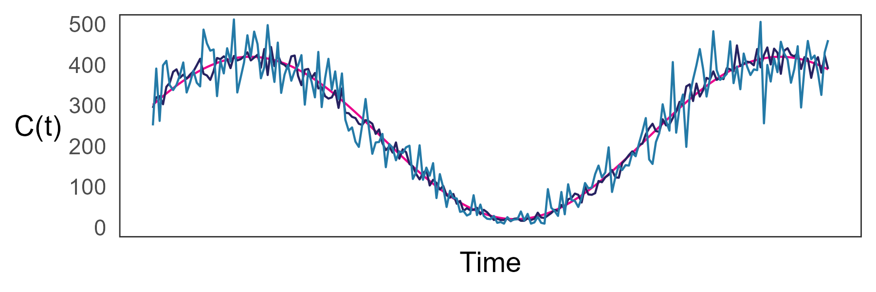
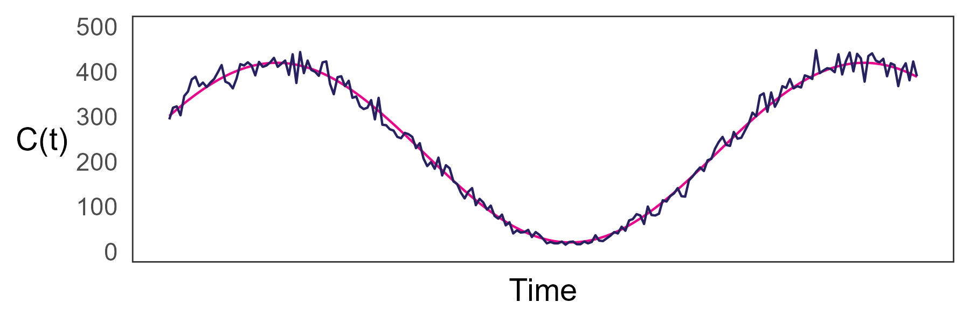
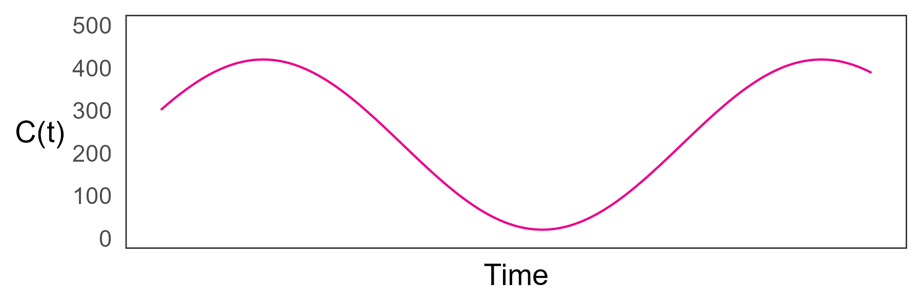
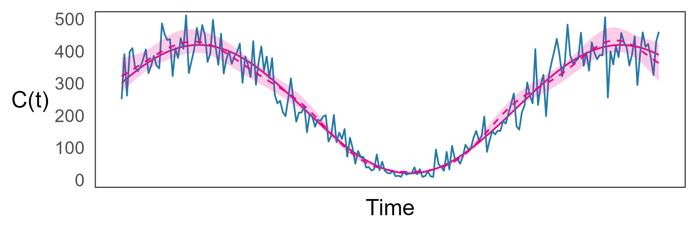
Fundamental noise
Any observation process will include noise in the observation/event.
Our aim is often to quantify the underlying trends in a time-series (i.e. the expected number of events through time).
Statistical methods can be used to quantify the underlying trends in an epidemic time-series, accounting for fundamental noise in the observation process.

Slide 8
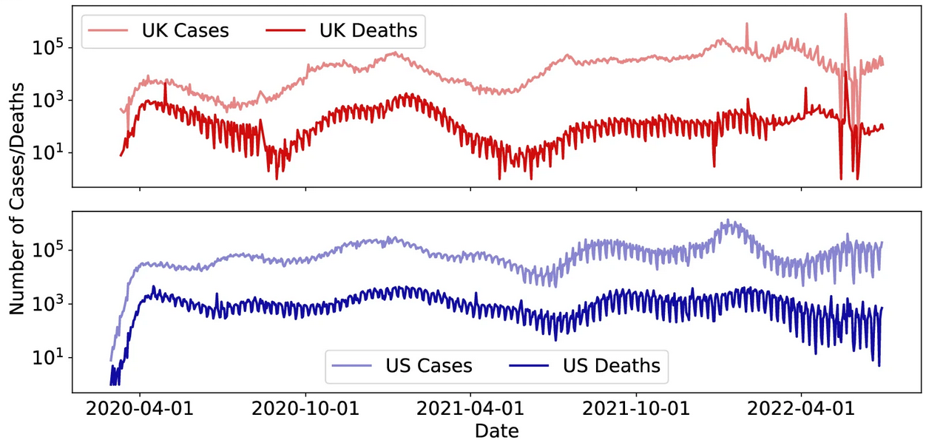
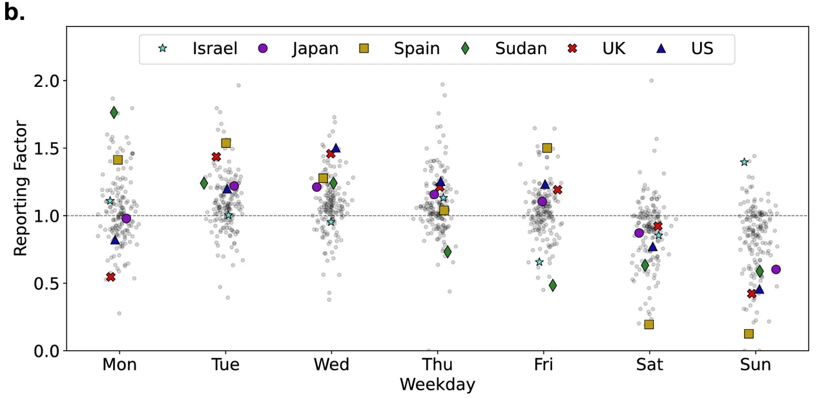
Day-of-the-week effects
Many epidemic time-series exhibit day-of-the-week effects
Specific days of the week will be consistently higher/lower
Day-of-the-week effects do not (usually) reflect epidemic dynamics
Reflect a bias in the observation process
Gallagher et al. 2025. BMC Research Notes

Slide 9
Accounting for noise

Slide 10
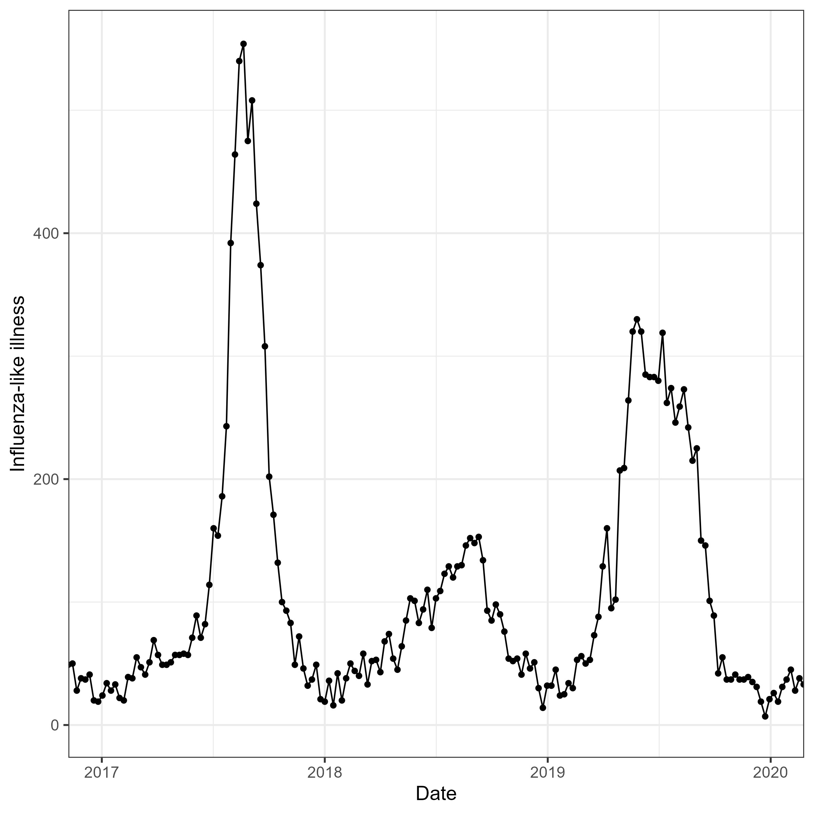
Why not aggregate into weekly data?
Aggregating data can improve visualisation but throws away information
There can still be substantial noise in e.g. weekly epidemic time-series

Slide 11
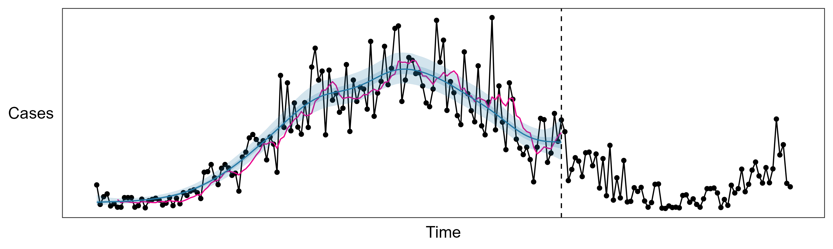
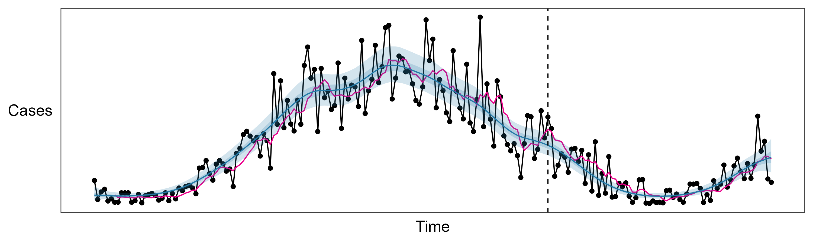
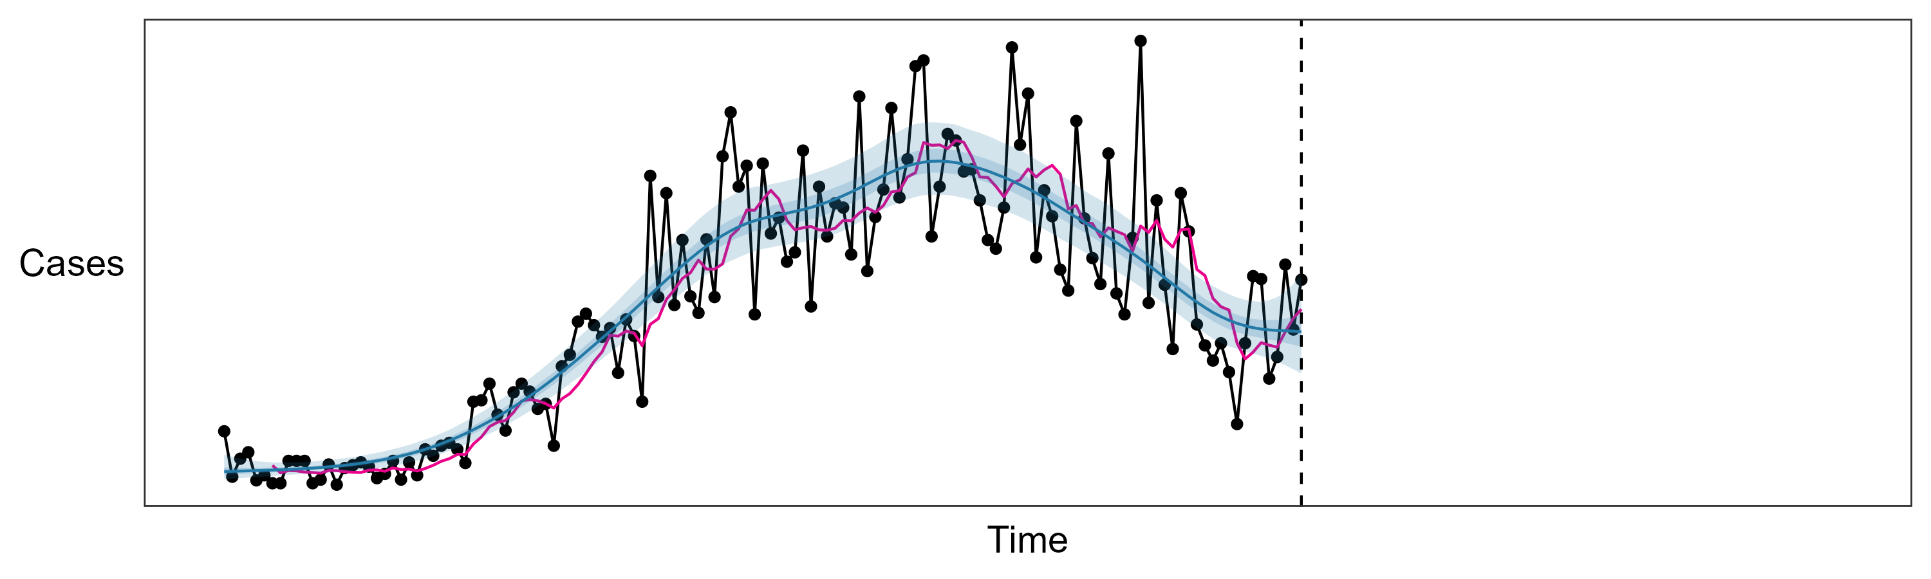
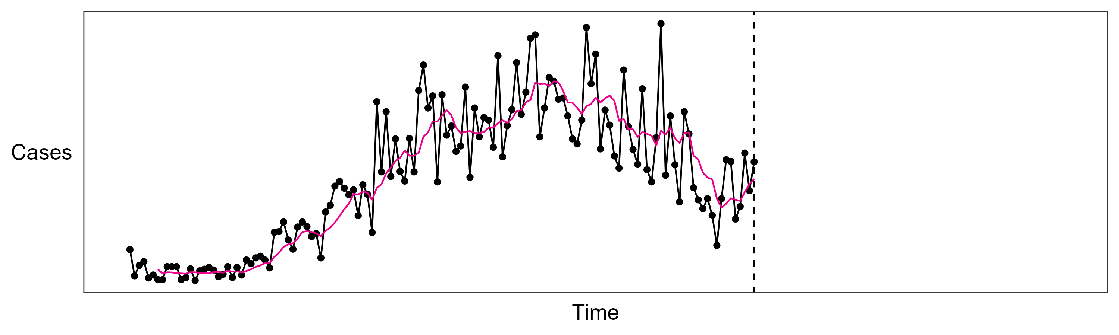
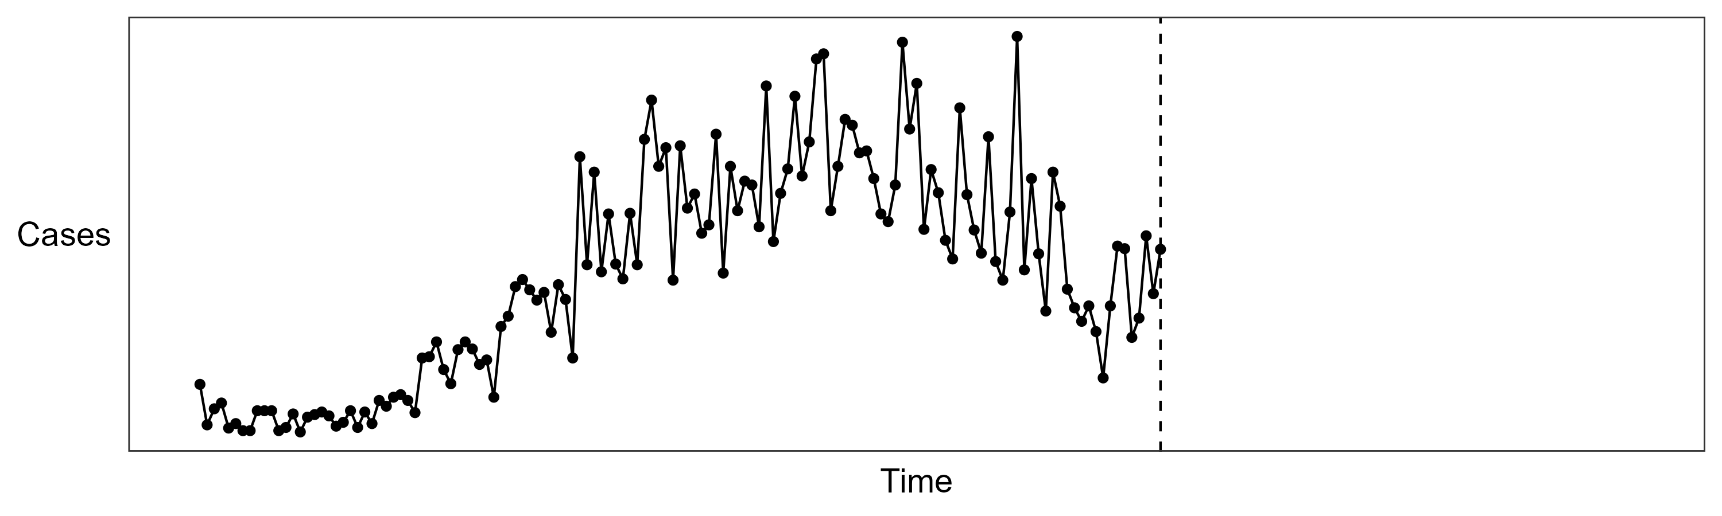
Why not a seven-day rolling average?
Rolling averages can remove the appearance of some noise, but they throw out information
Do not capture uncertainty in trends
Better to use a statistical approach
Statistical models can be used to separate meaningful trends in the data from noise

Slide 12
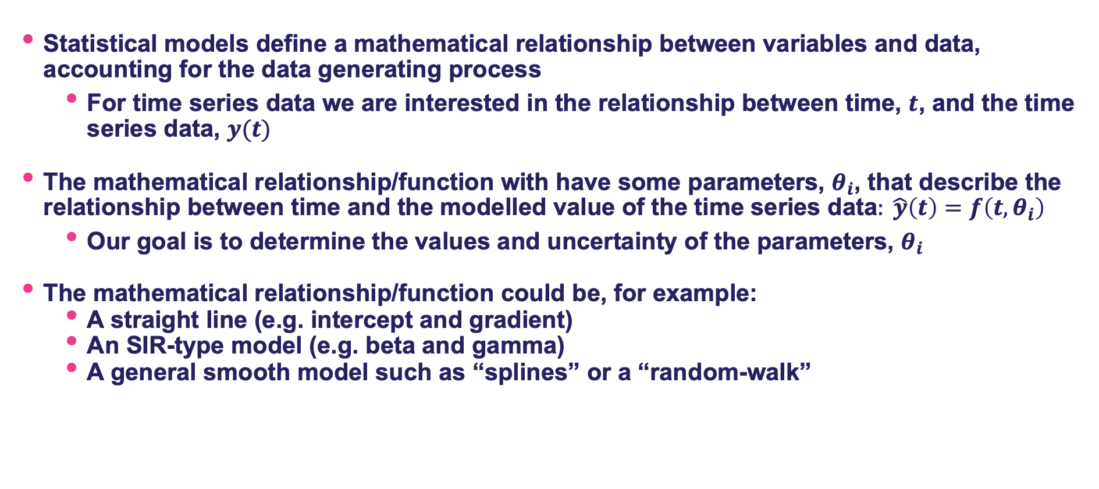
Statistical approaches
Statistical models define a mathematical relationship between variables and data, accounting for the data generating process
For time series data we are interested in the relationship between time, $t$, and the time series data, $y(t)$
The mathematical relationship/function with have some parameters, $θ_{i}$, that describe the relationship between time and the modelled value of the time series data$: \hat{y}\left(t\right)=f\left(t, θ_{i}\right)$
Our goal is to determine the values and uncertainty of the parameters, $θ_{i}$
The mathematical relationship/function could be, for example:
A straight line (e.g. intercept and gradient)
An SIR-type model (e.g. beta and gamma)
A general smooth model such as “splines” or a “random-walk”

Slide 13
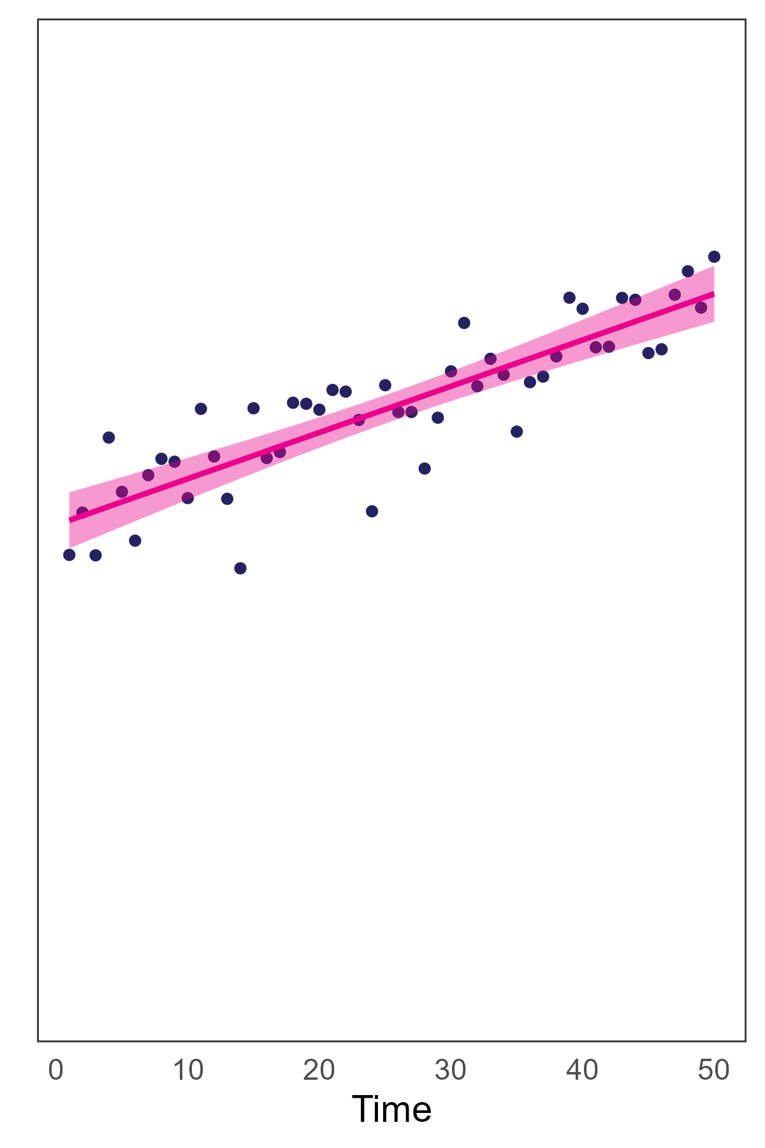
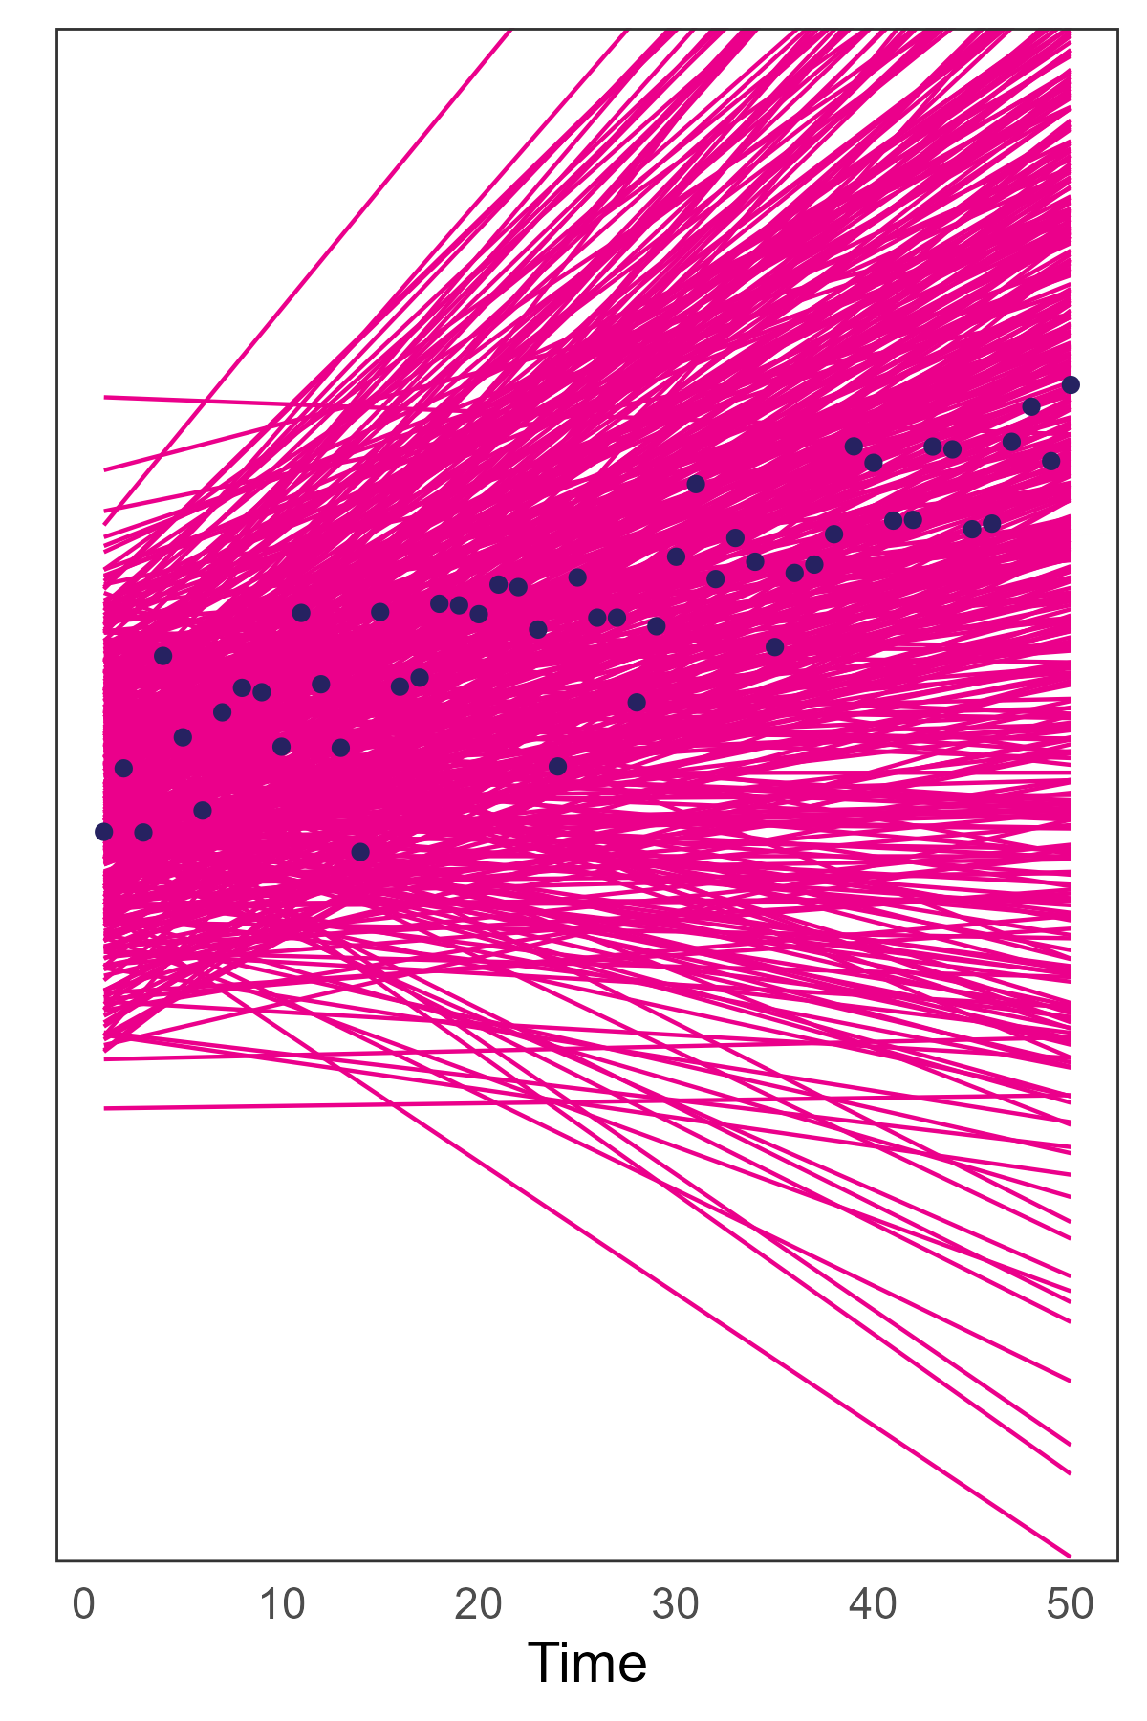
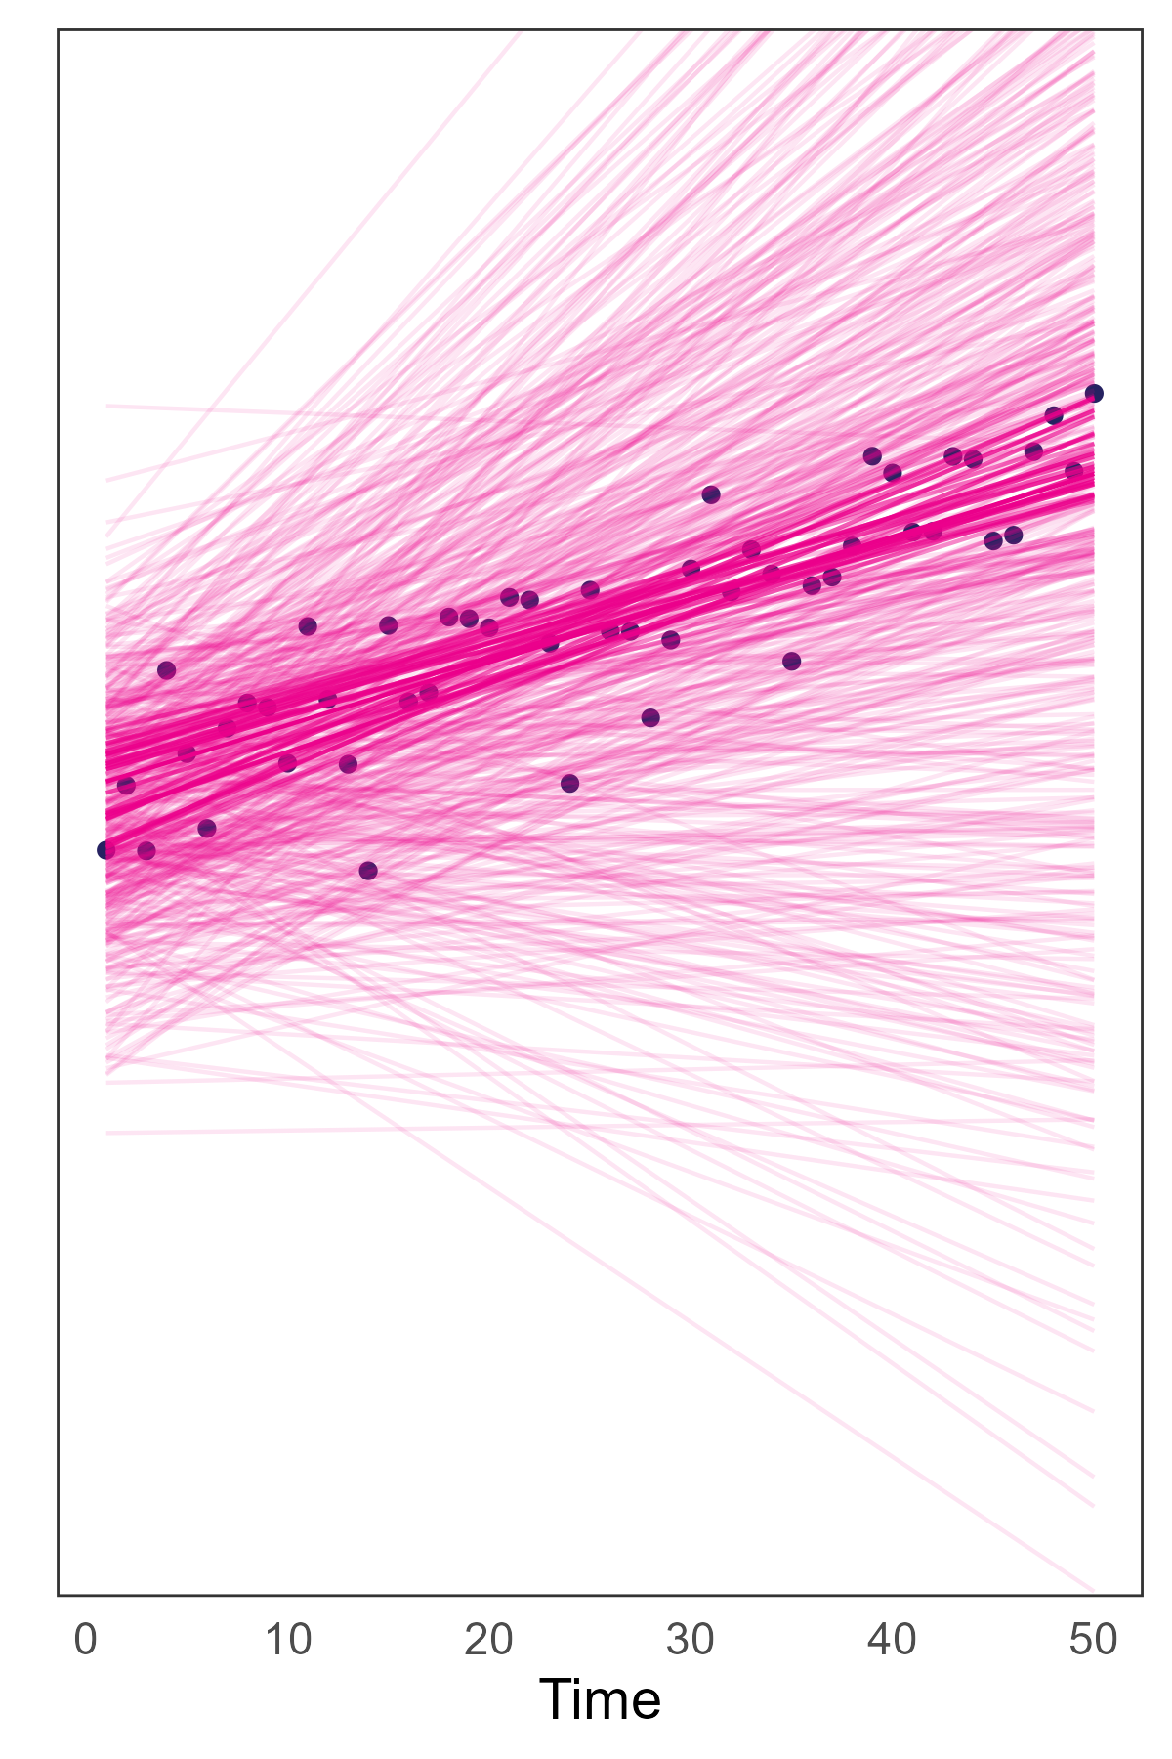
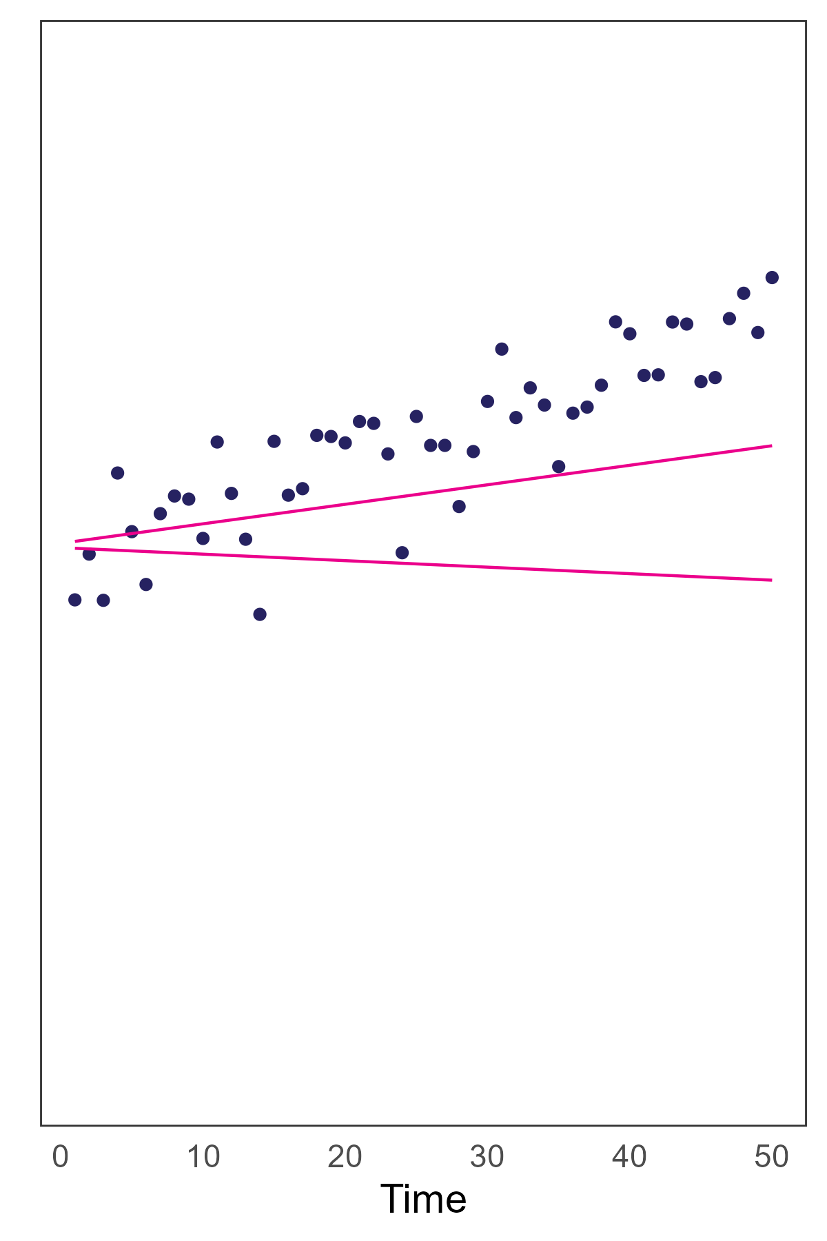
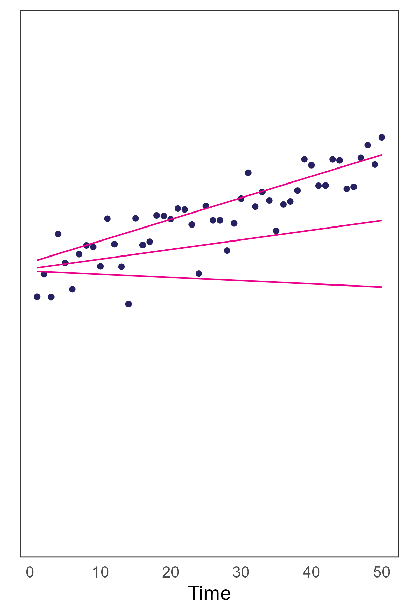
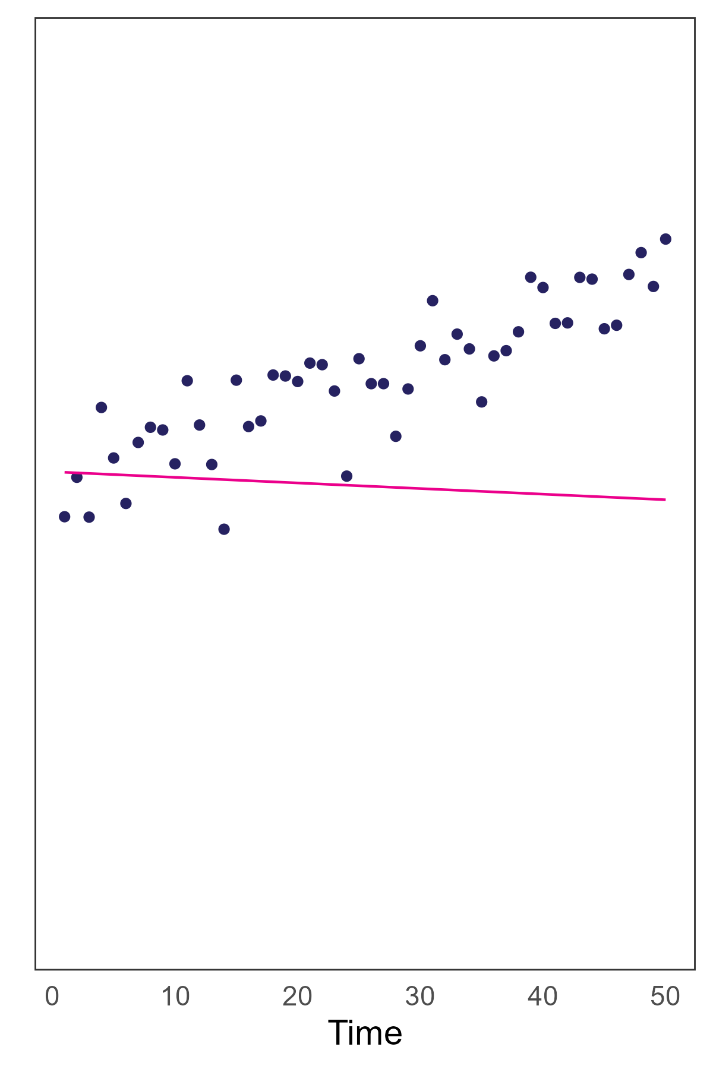
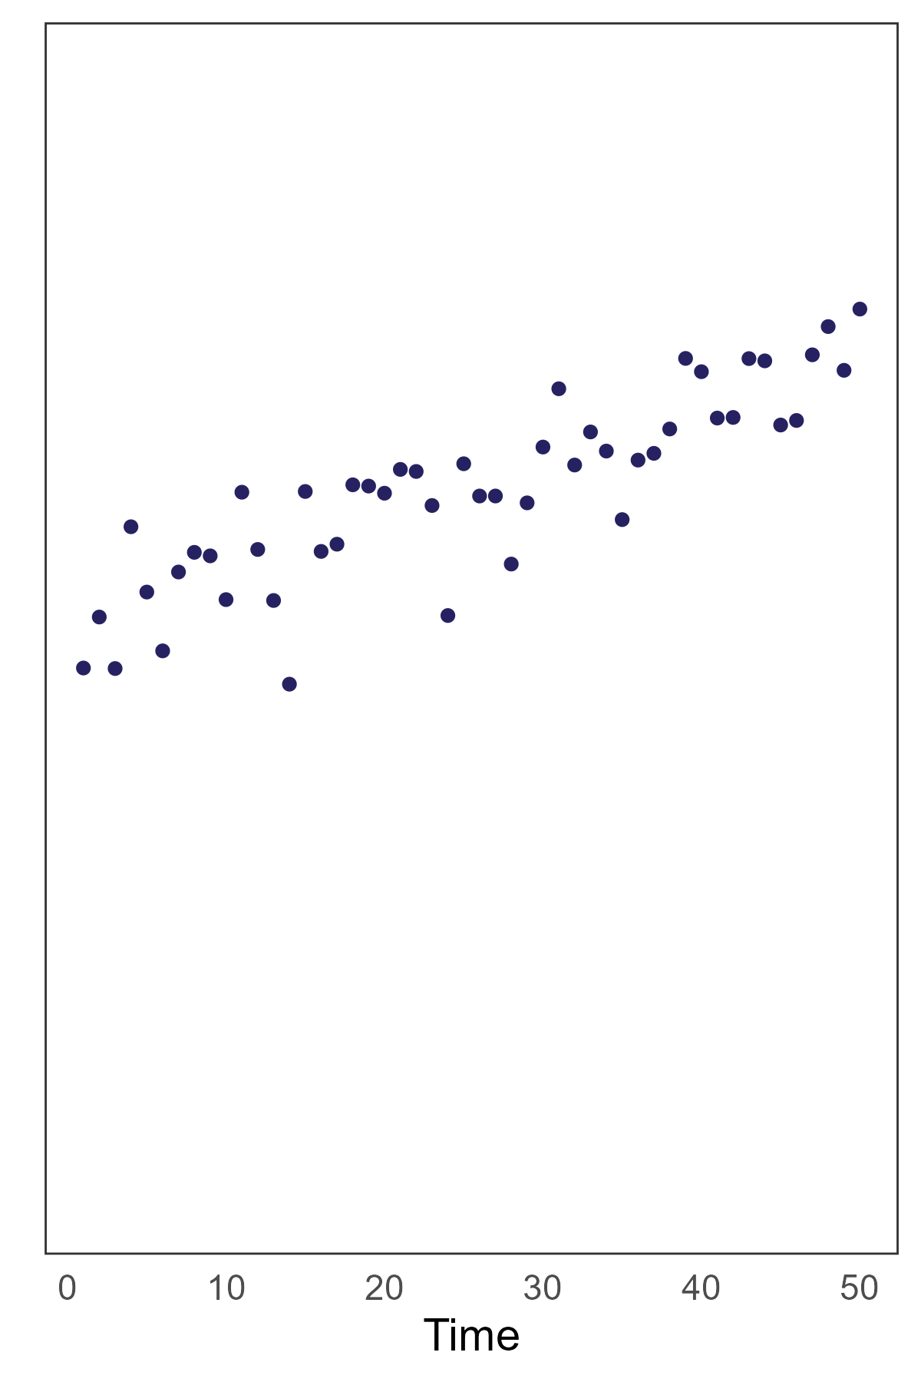
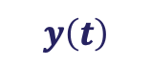
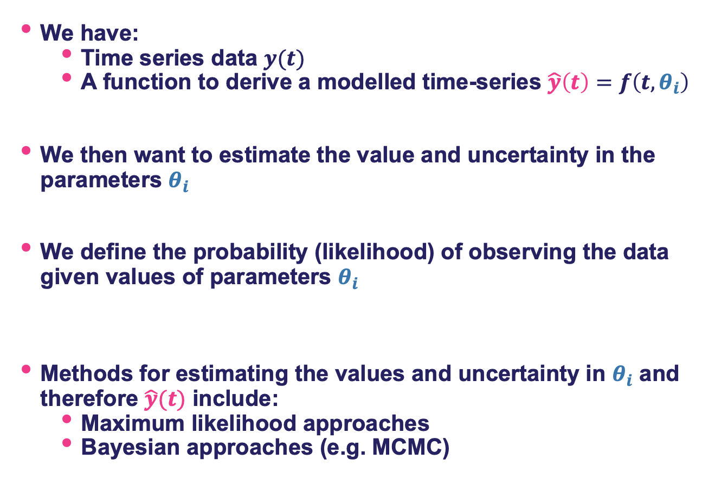
Statistical approaches
$$\hat{y}\left(t\right)=m×t+c$$
We have:
Time series data $y(t)$
A function to derive a modelled time-series $\hat{y}\left(t\right)=f\left(t, θ_{i}\right)$
We then want to estimate the value and uncertainty in the parameters $θ_{i}$
We define the probability (likelihood) of observing the data given values of parameters $θ_{i}$
Methods for estimating the values and uncertainty in $θ_{i}$ and therefore $\hat{y}(t)$ include:
Maximum likelihood approaches
Bayesian approaches (e.g. MCMC)
$$y\left(t\right)$$

Slide 14
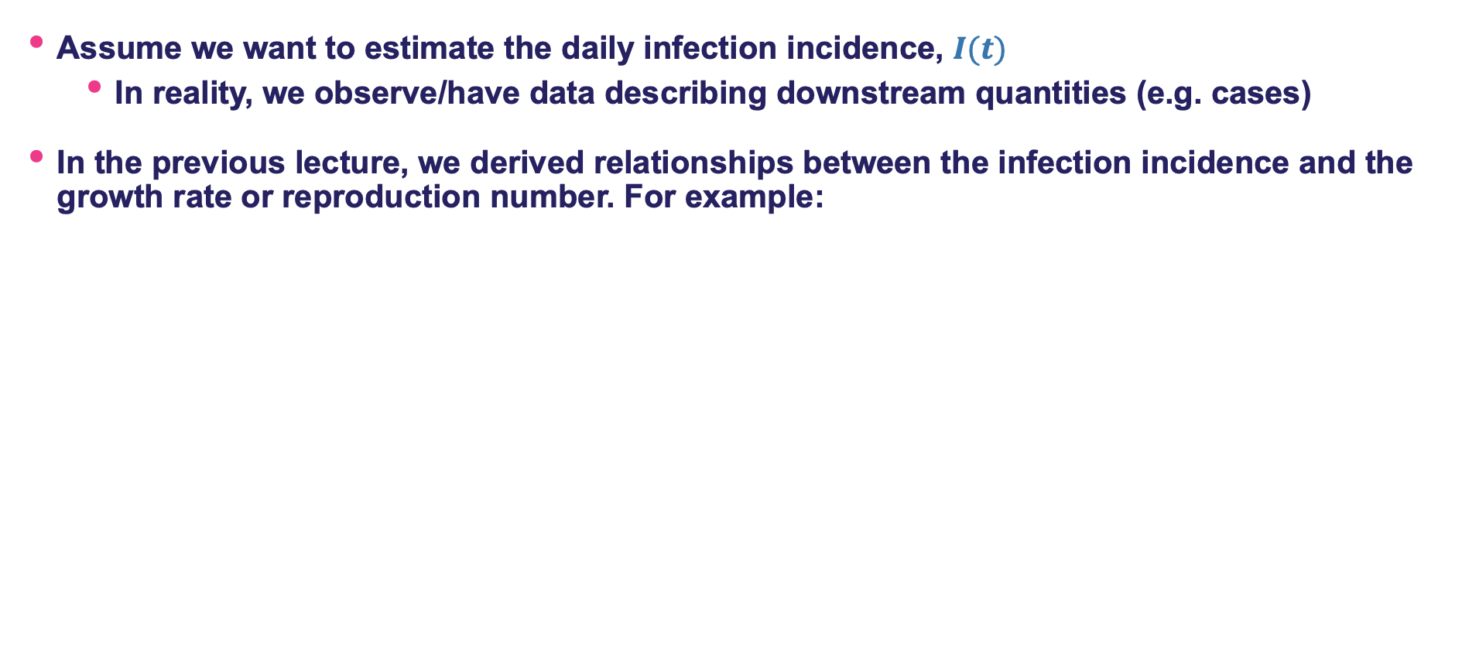
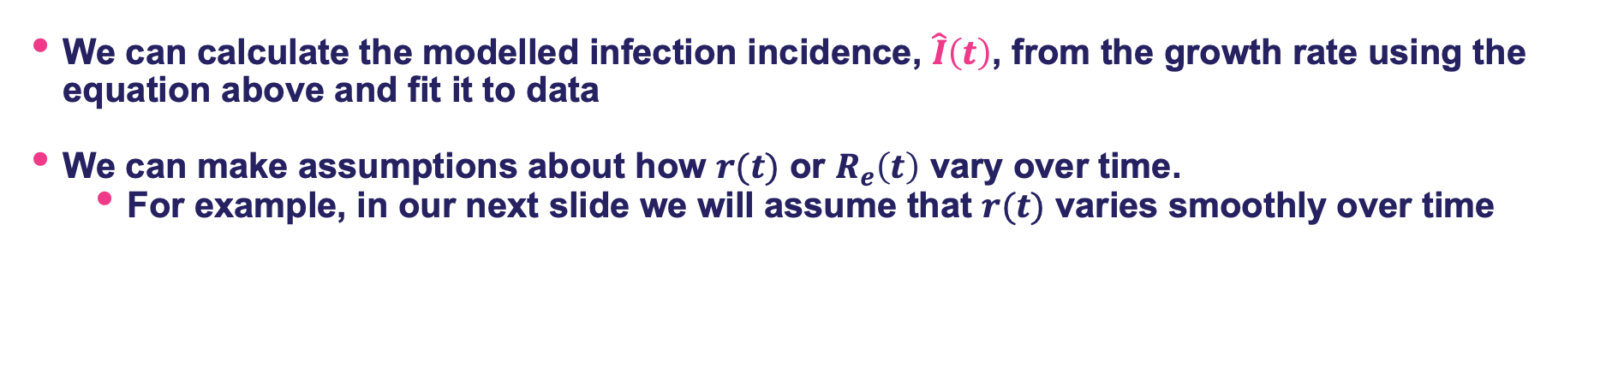

Statistical approaches
Assume we want to estimate the daily infection incidence, $I(t)$
In reality, we observe/have data describing downstream quantities (e.g. cases)
In the previous lecture, we derived relationships between the infection incidence and the growth rate or reproduction number. For example:
$$\hat{I}\left(t\right)=\hat{I}{(t−1)e}^{r(t)}$$
Infection incidence at current time
Growth rate from previous time to current time
Infection incidence at previous time
We can calculate the modelled infection incidence, $\hat{I}\left(t\right)$, from the growth rate using the equation above and fit it to data
We can make assumptions about how $r(t)$ or $R_{e}\left(t\right)$ vary over time.
For example, in our next slide we will assume that $r(t)$ varies smoothly over time

Slide 15
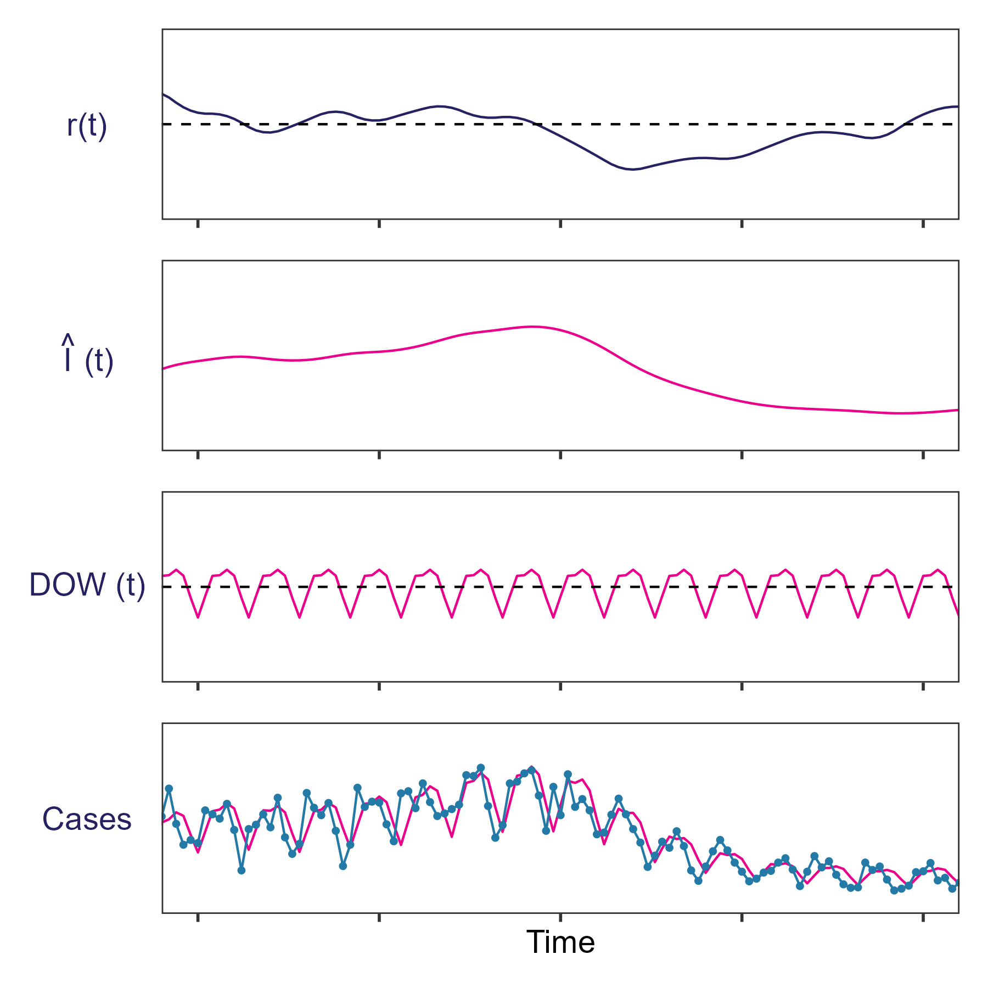

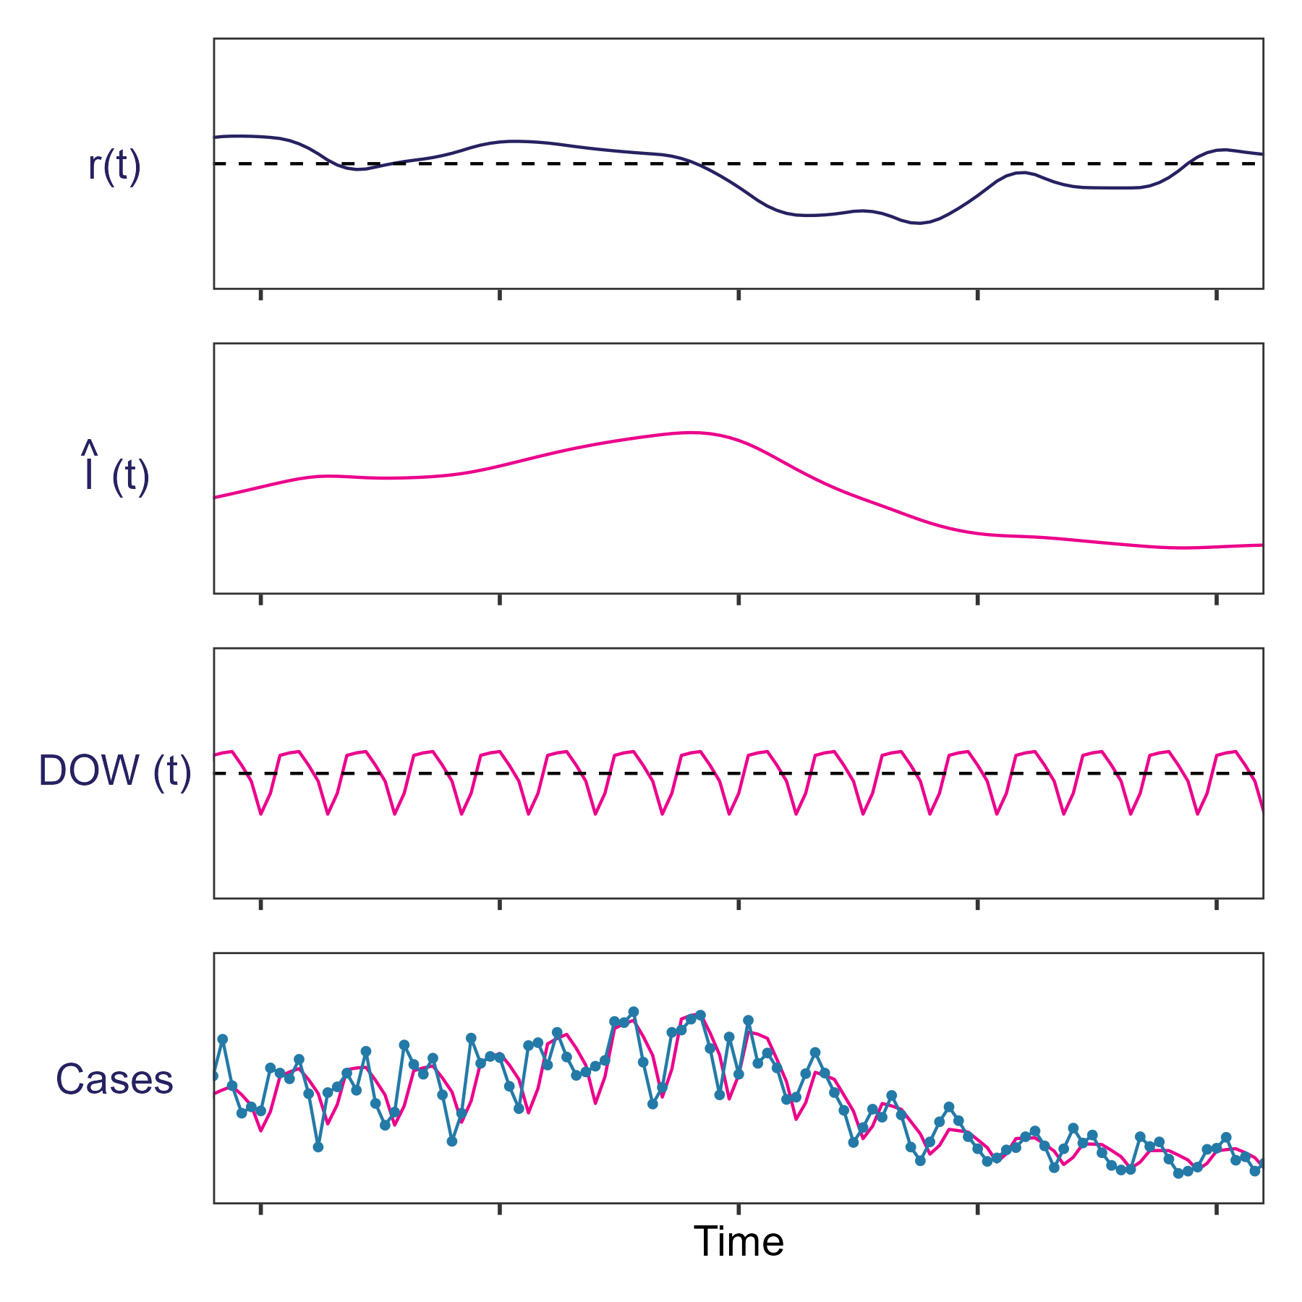
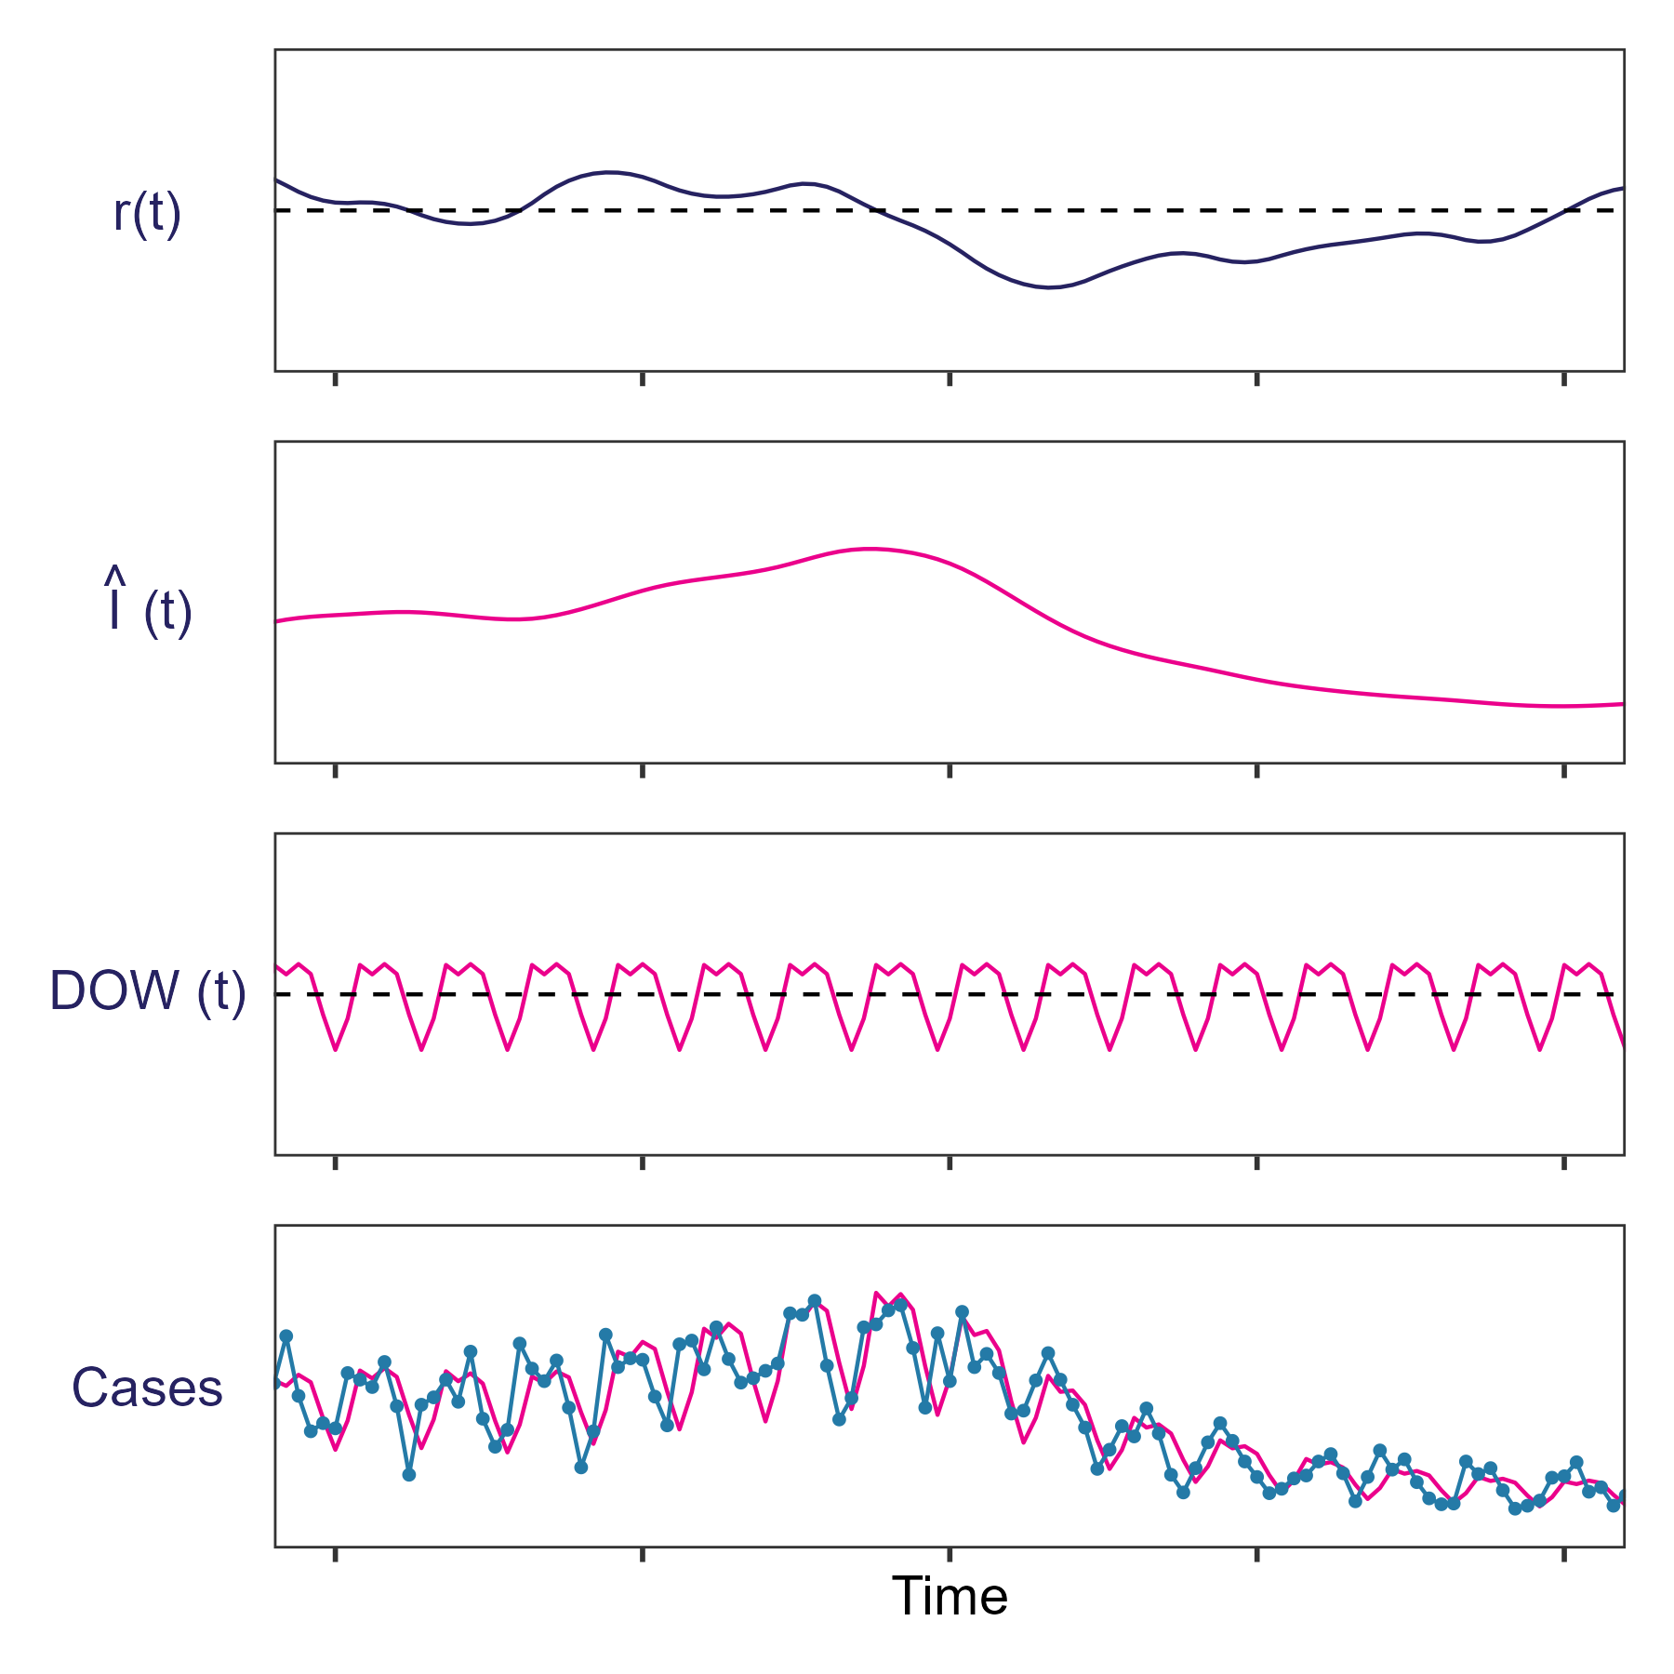

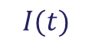
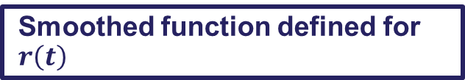
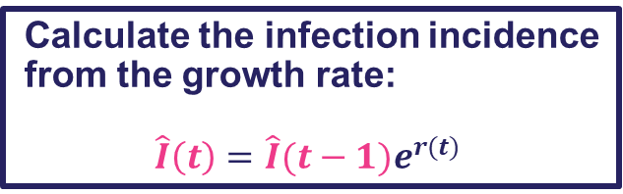
Statistical approaches
Smoothed function defined for $r\left(t\right)$
Calculate the infection incidence from the growth rate:
$$\hat{I}\left(t\right)=\hat{I}{(t−1)e}^{r(t)}$$
Additional effects: e.g. day-of-the-week effect multiplier
$$DOW(t)$$
Probability of data given modelled values
$$I(t)$$

Slide 16
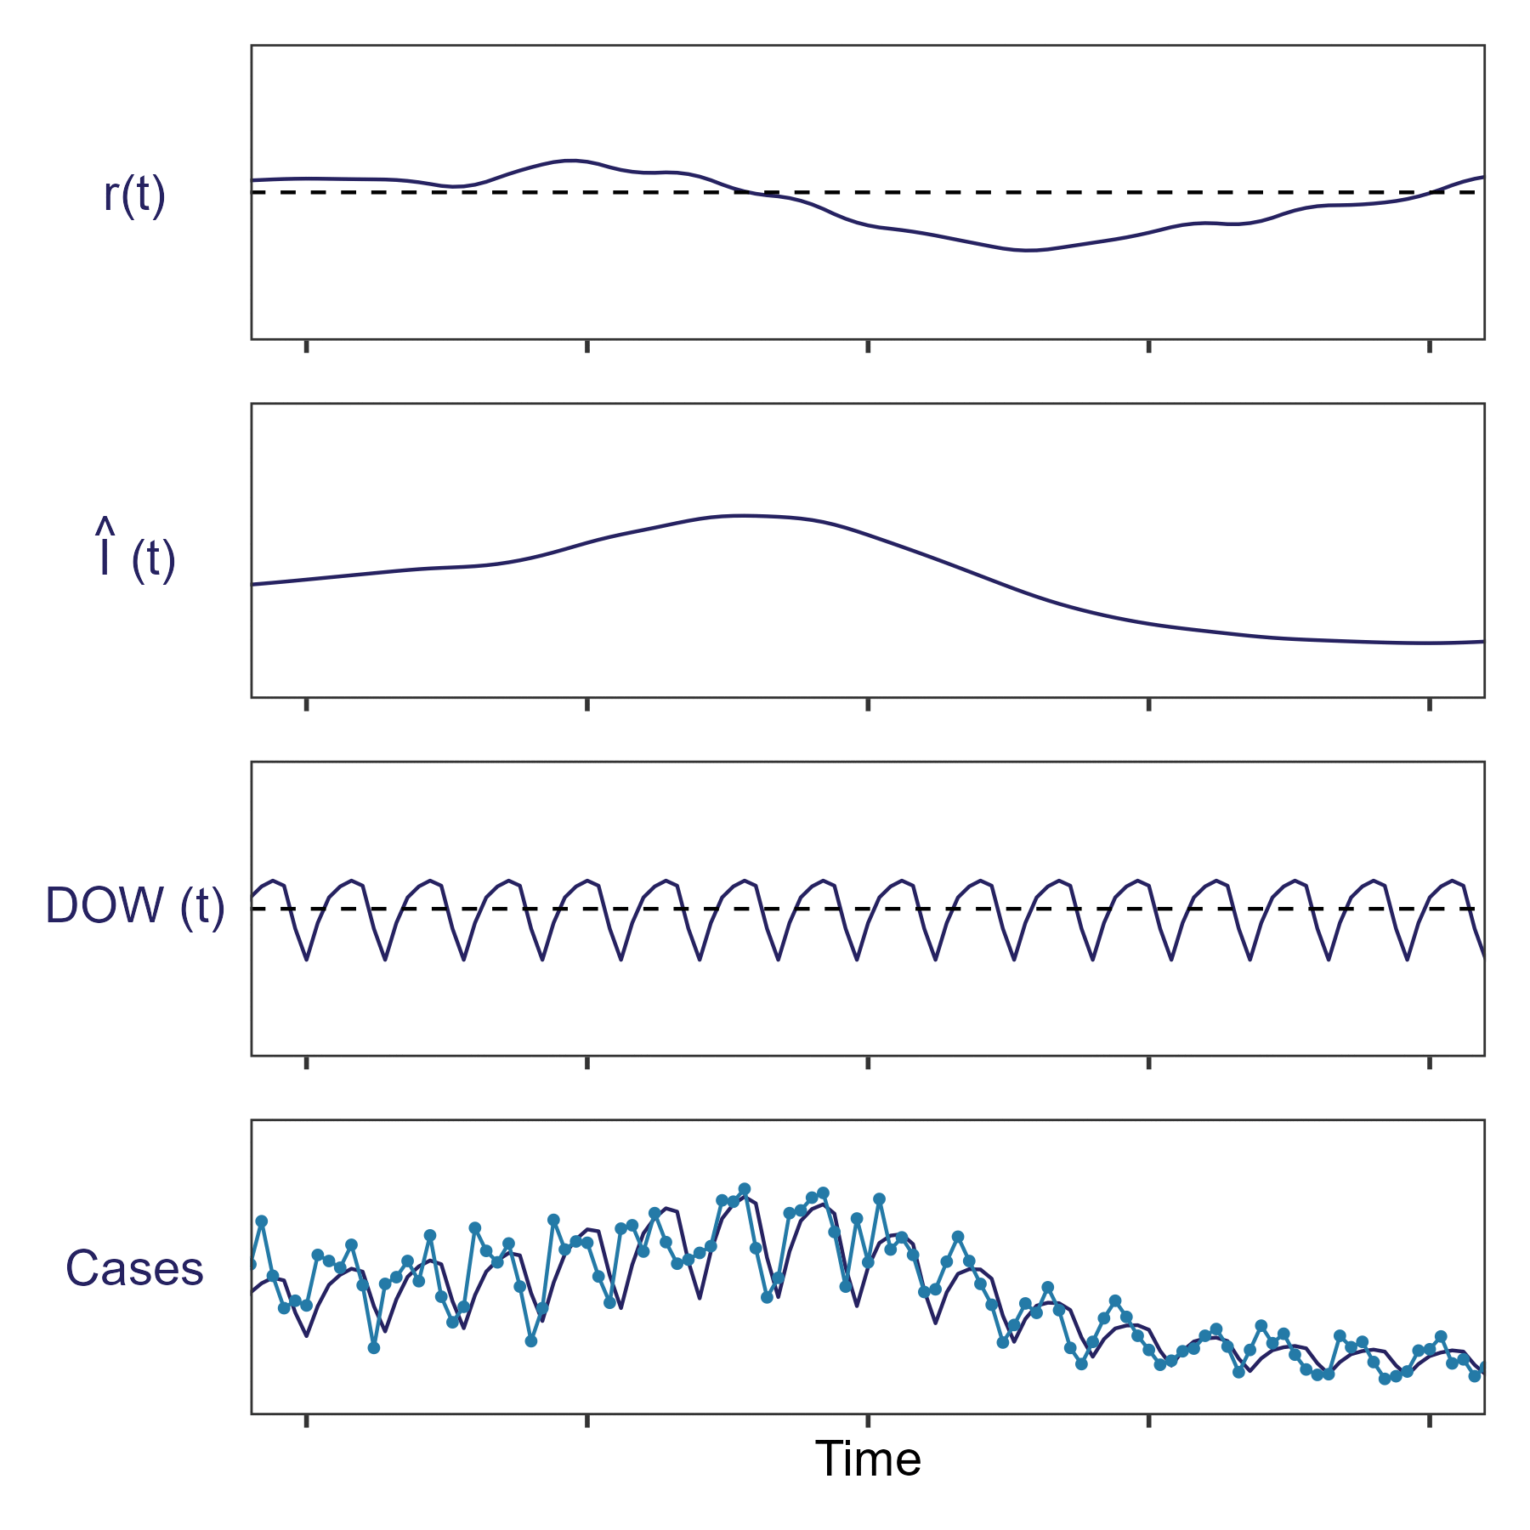
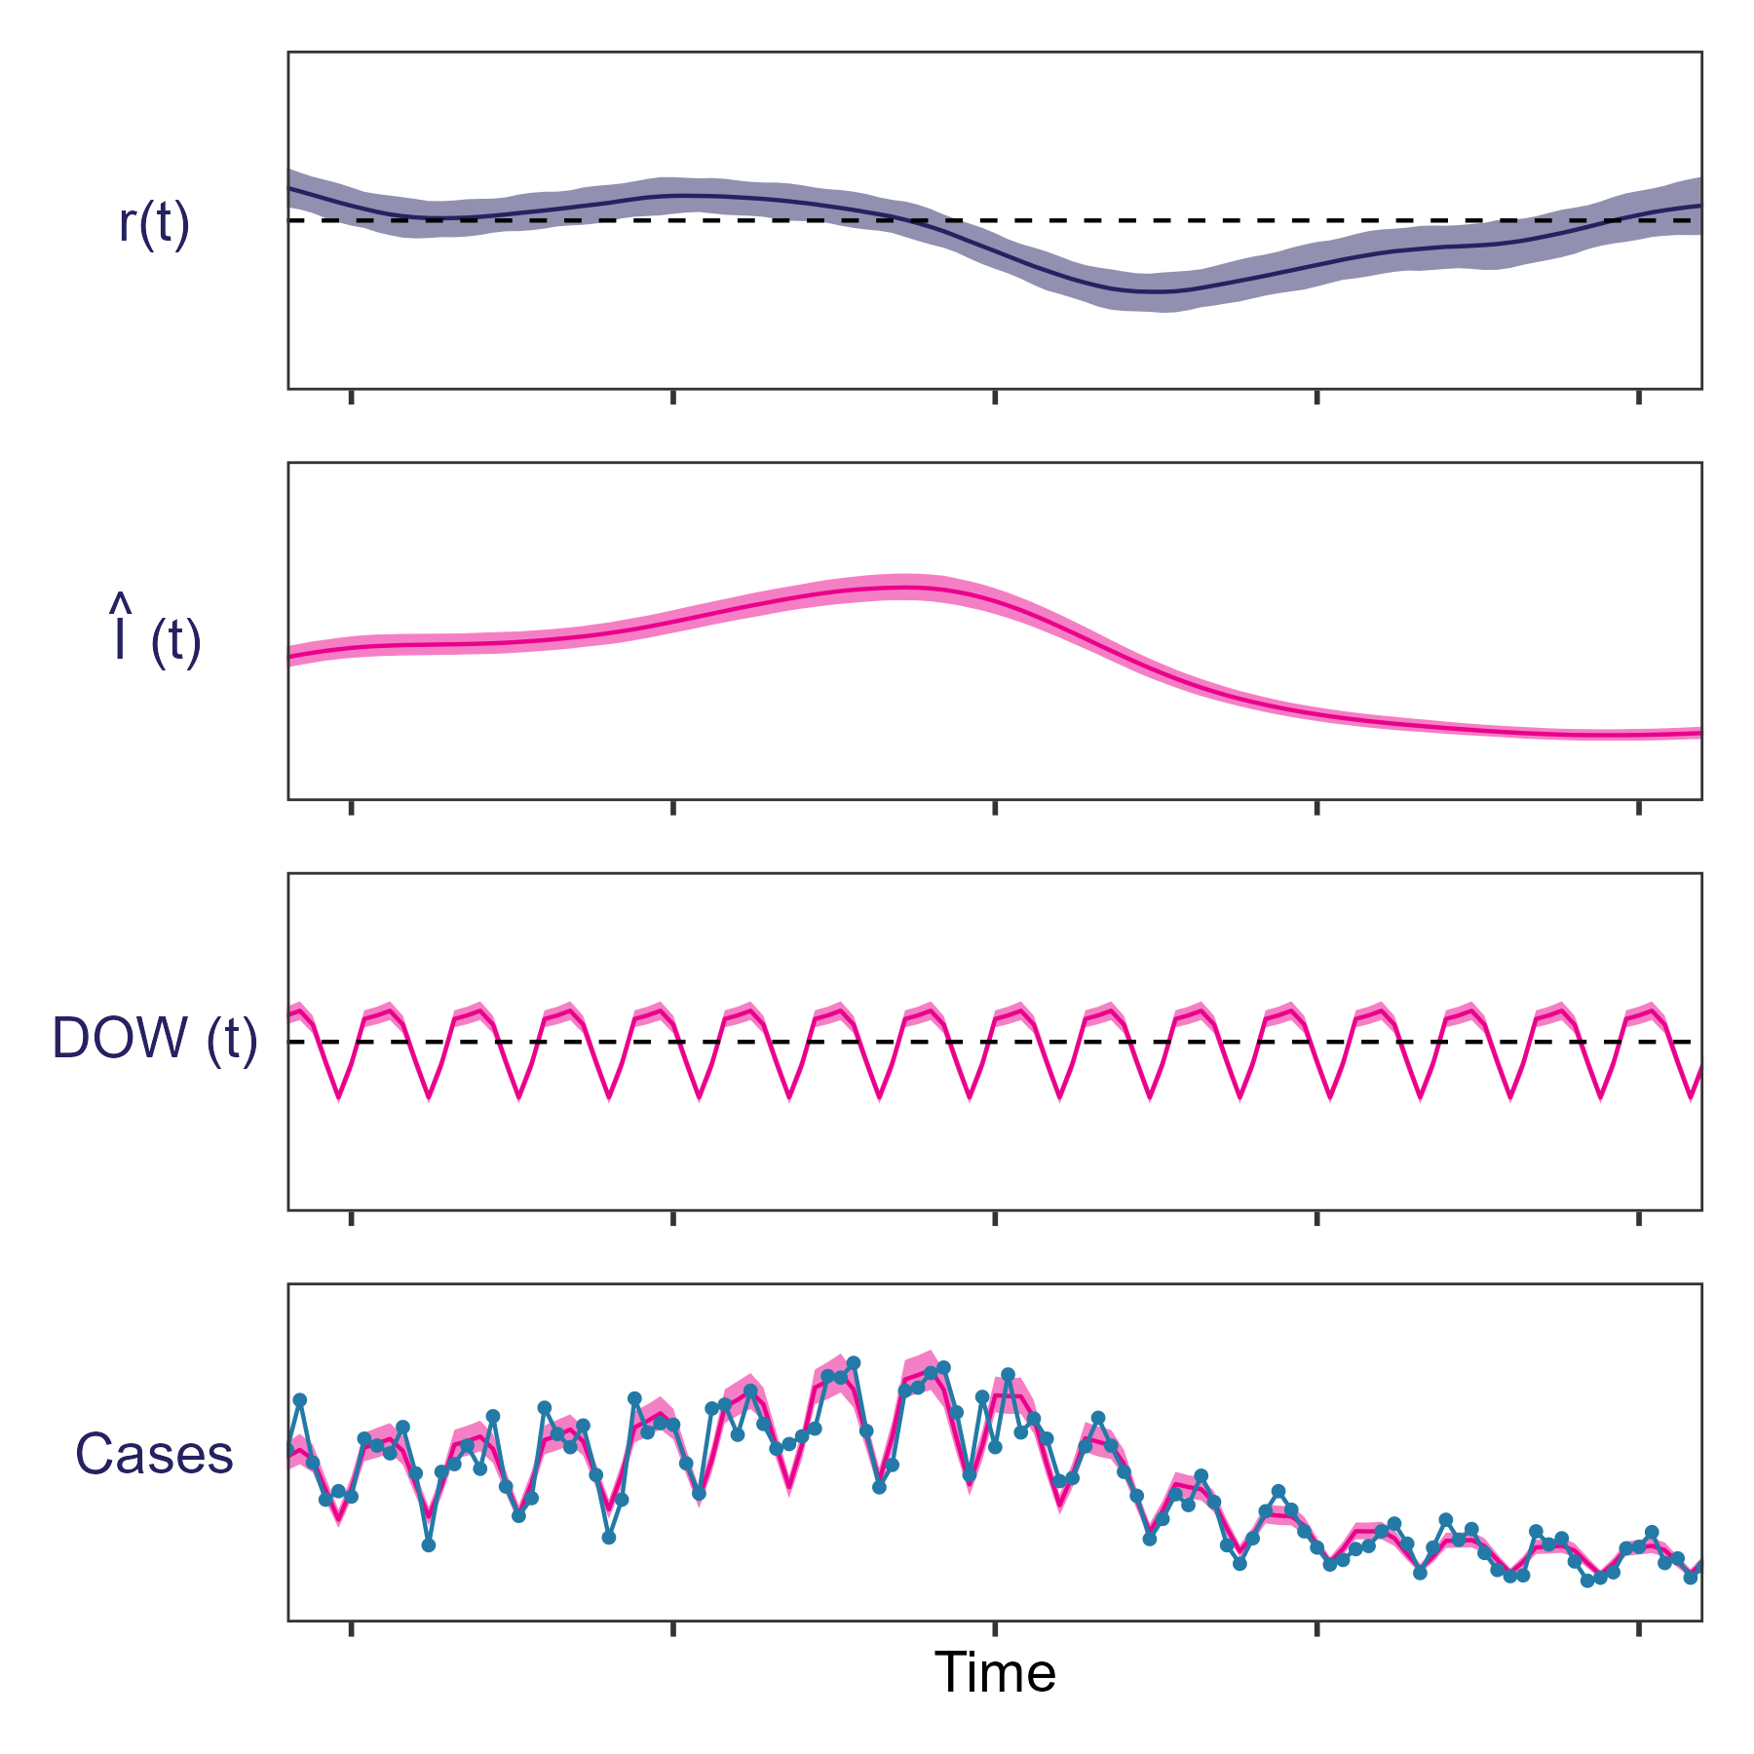
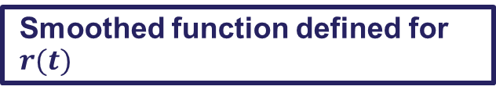
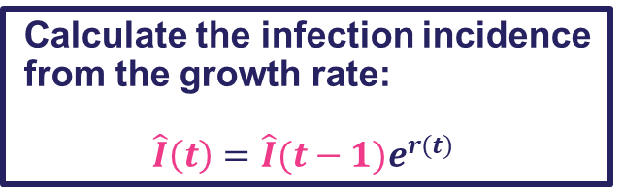
Statistical approaches
Smoothed function defined for $r(t)$
Calculate the infection incidence from the growth rate:
$$\hat{I}\left(t\right)=\hat{I}{(t−1)e}^{r(t)}$$
Additional effects: e.g. day-of-the-week effect multiplier
$$DOW(t)$$
Probability of data given modelled values
$$I(t)$$
16

Slide 17
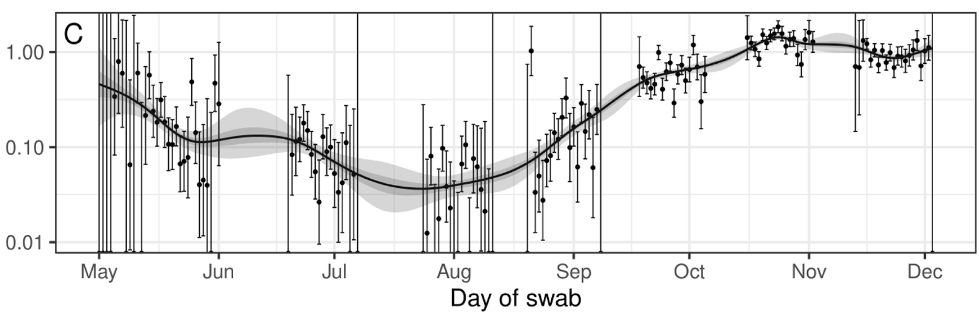
Other sources of noise
There are other sources of noise that can also be accounted for by statistical approaches
Data integrity is crucial for allowing appropriate statistical methods to be employed
For example:
Missing periods of data
Missing data fields
It is important when data is missing that it is recorded as such
Statistical models can incorporate the additional uncertainty of missing data
Eales et al. 2022. Epidemics

Slide 18
Accounting for delays in epidemic time series

Slide 19
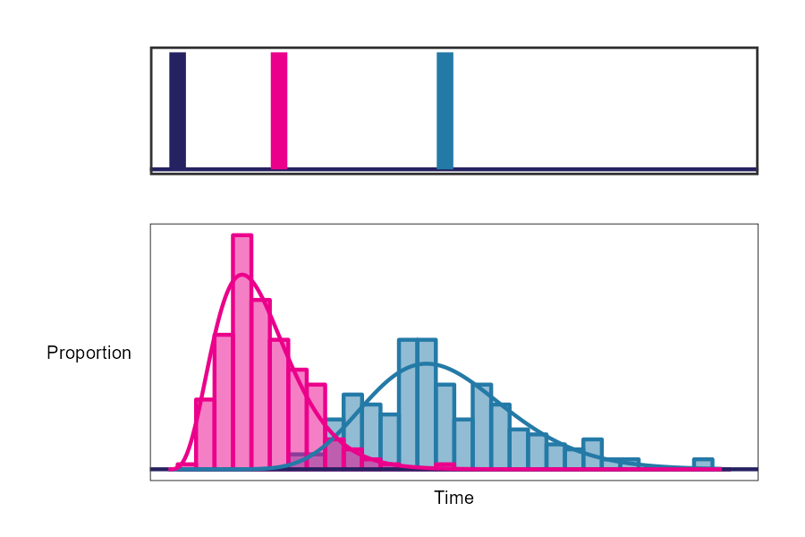
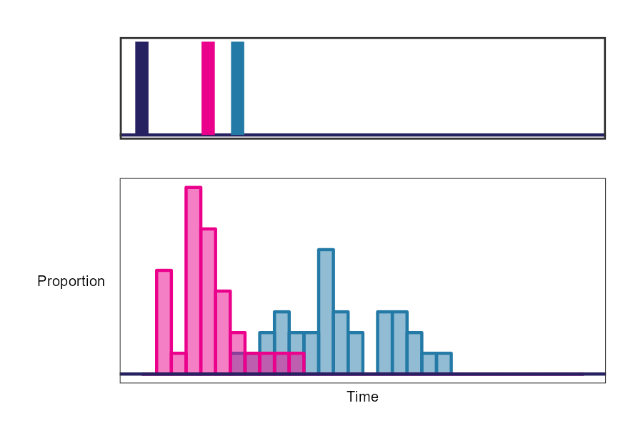
Downstream outcomes of infection
Common epidemic time-series (e.g. cases, hospitalisations, deaths) are downstream outcomes of infection
Not all infections:
will be identified as a case
result in hospitalisation or death
The timing of outcomes can vary between individuals
Time
Time
Infection
Hospitalisation
Infection
Case identified
Hospitalisation
Case identified

Slide 20
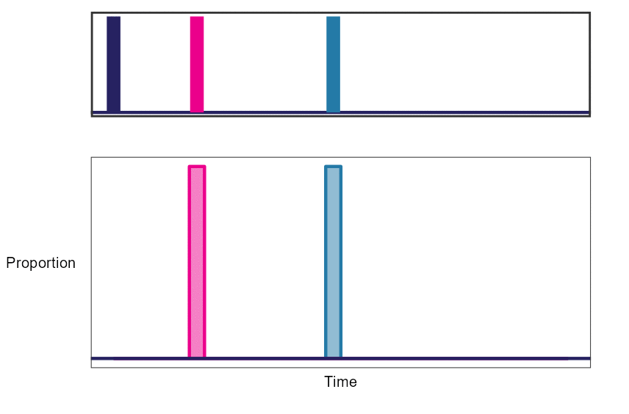
Downstream outcomes of infection
The time between infection and downstream outcomes can be described by a probability distribution
Event
Infection
Case identified
Hospitalisation
Delay distribution
Infection to case
Infection to hospitalisation

Slide 21
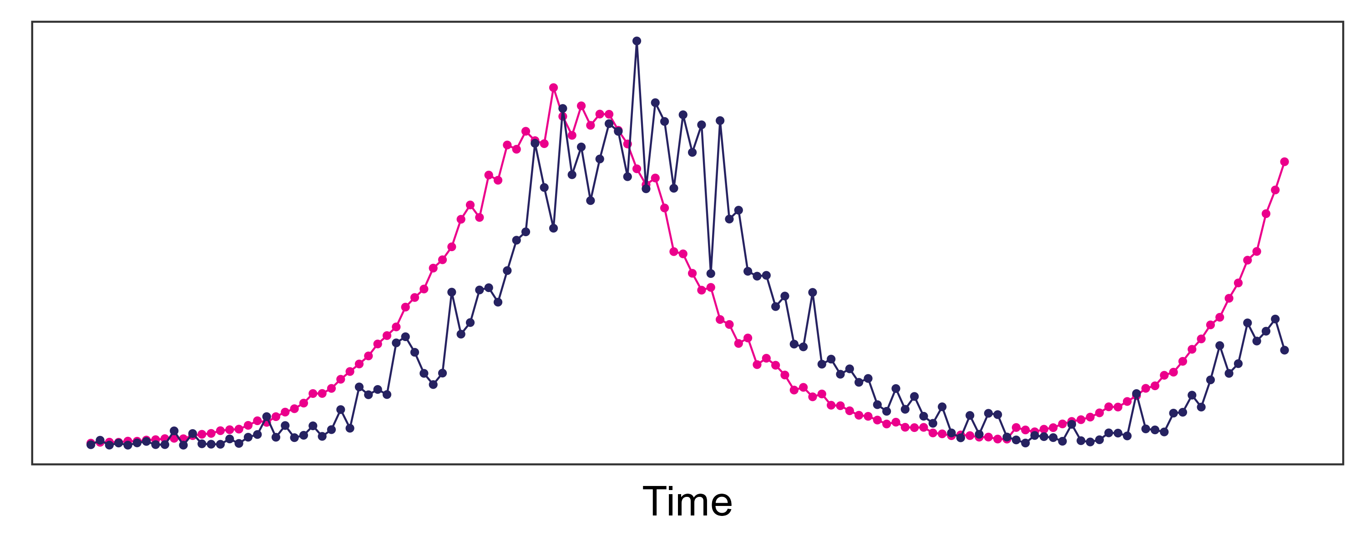
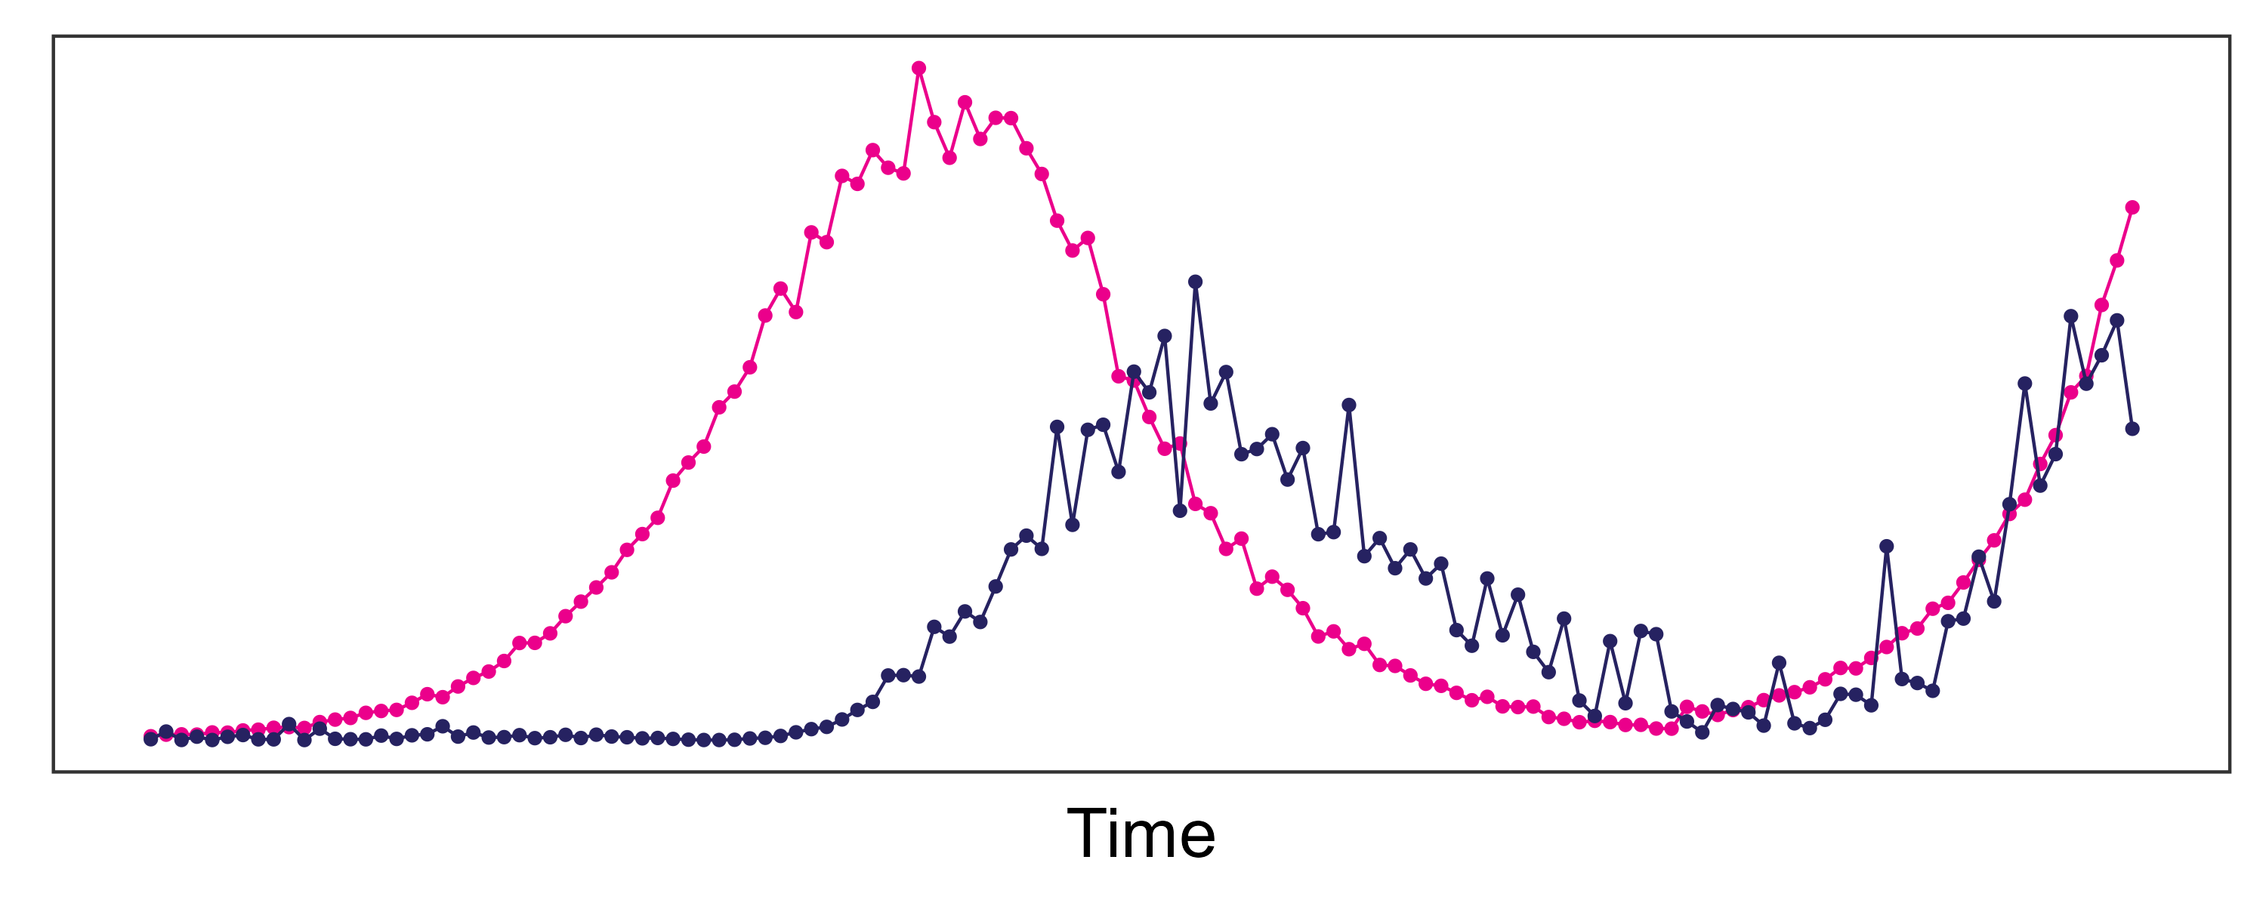
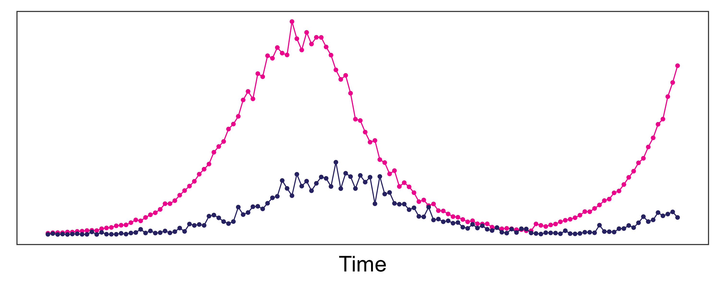
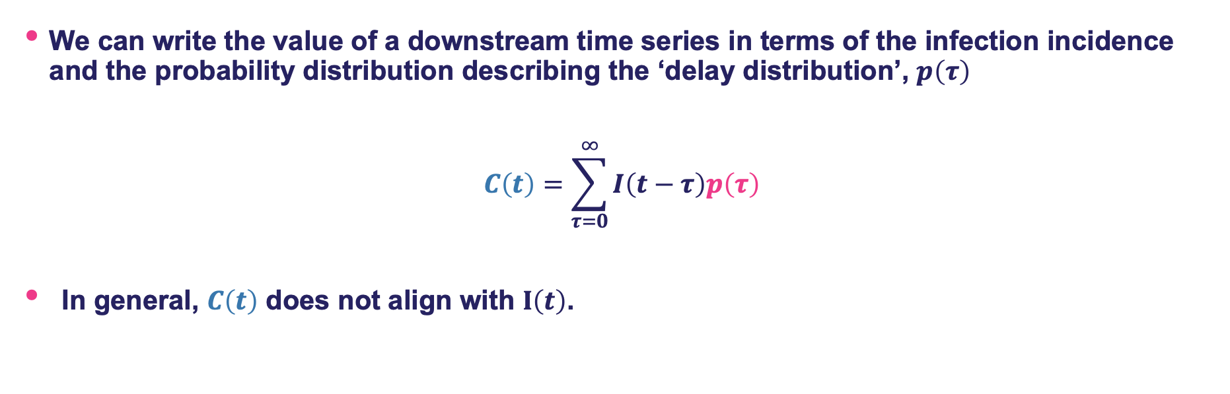
Relationship between downstream time series and infection incidence
We can write the value of a downstream time series in terms of the infection incidence and the probability distribution describing the ‘delay distribution’, $p\left(τ\right)$
$$C\left(t\right)=\sum_{τ=0}^{∞}{I\left(t−τ\right)p\left(τ\right)}$$
In general, $C\left(t\right)$ does not align with $I\left(t\right)$.
Distribution of delays from infection to confirmed case
Cases on current day
Infection incidence on previous days
Infections
Cases
See Eales et al. 2024. Royal Society Open Science for further discussion

Slide 22
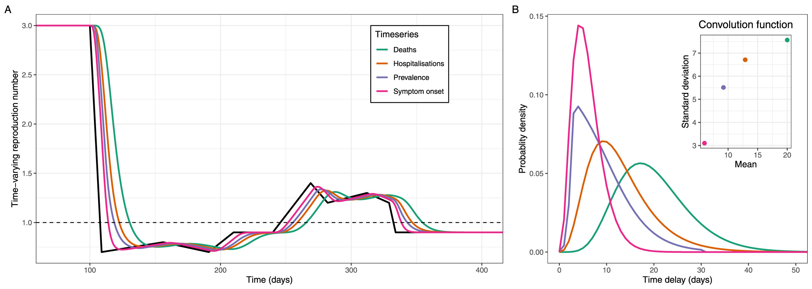
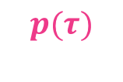
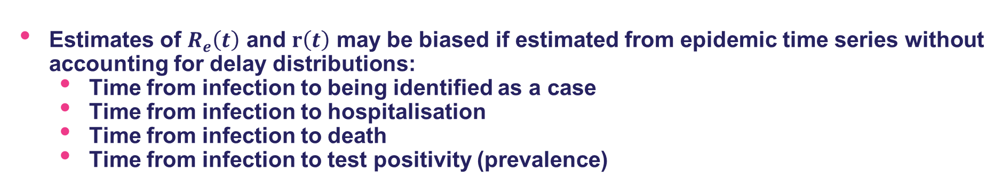
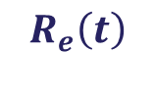
Relationship between downstream time series and infection incidence
Estimates of $R_{e}\left(t\right)$ and $r\left(t\right)$ may be biased if estimated from epidemic time series without accounting for delay distributions:
Time from infection to being identified as a case
Time from infection to hospitalisation
Time from infection to death
Time from infection to test positivity (prevalence)
$$R_{e}\left(t\right)$$
Delay distributions
$$p(τ)$$
See Eales et al. 2024. Epidemics for further discussion

Slide 23
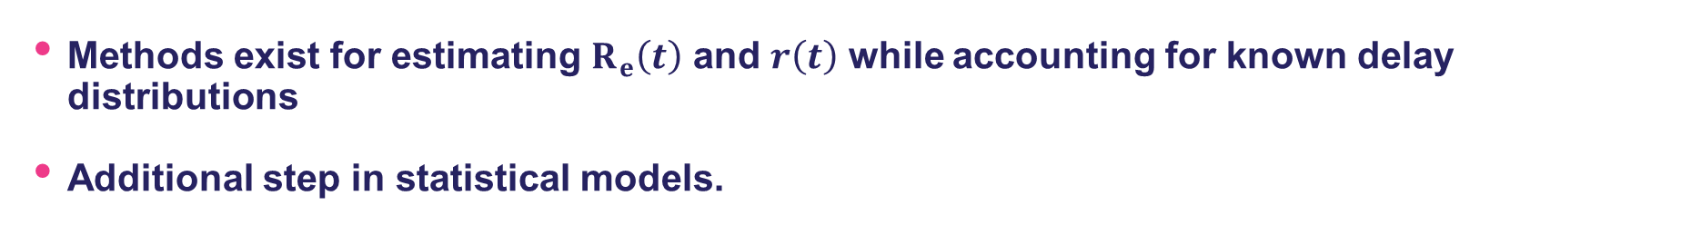
Methods to account for delay distributions
Methods exist for estimating $R_{e}\left(t\right)$ and $r\left(t\right)$ while accounting for known delay distributions
Additional step in statistical models.
There are multiple R packages that allow for a delay distribution to be provided and accounted for:
We will use EpiNow2

Slide 24
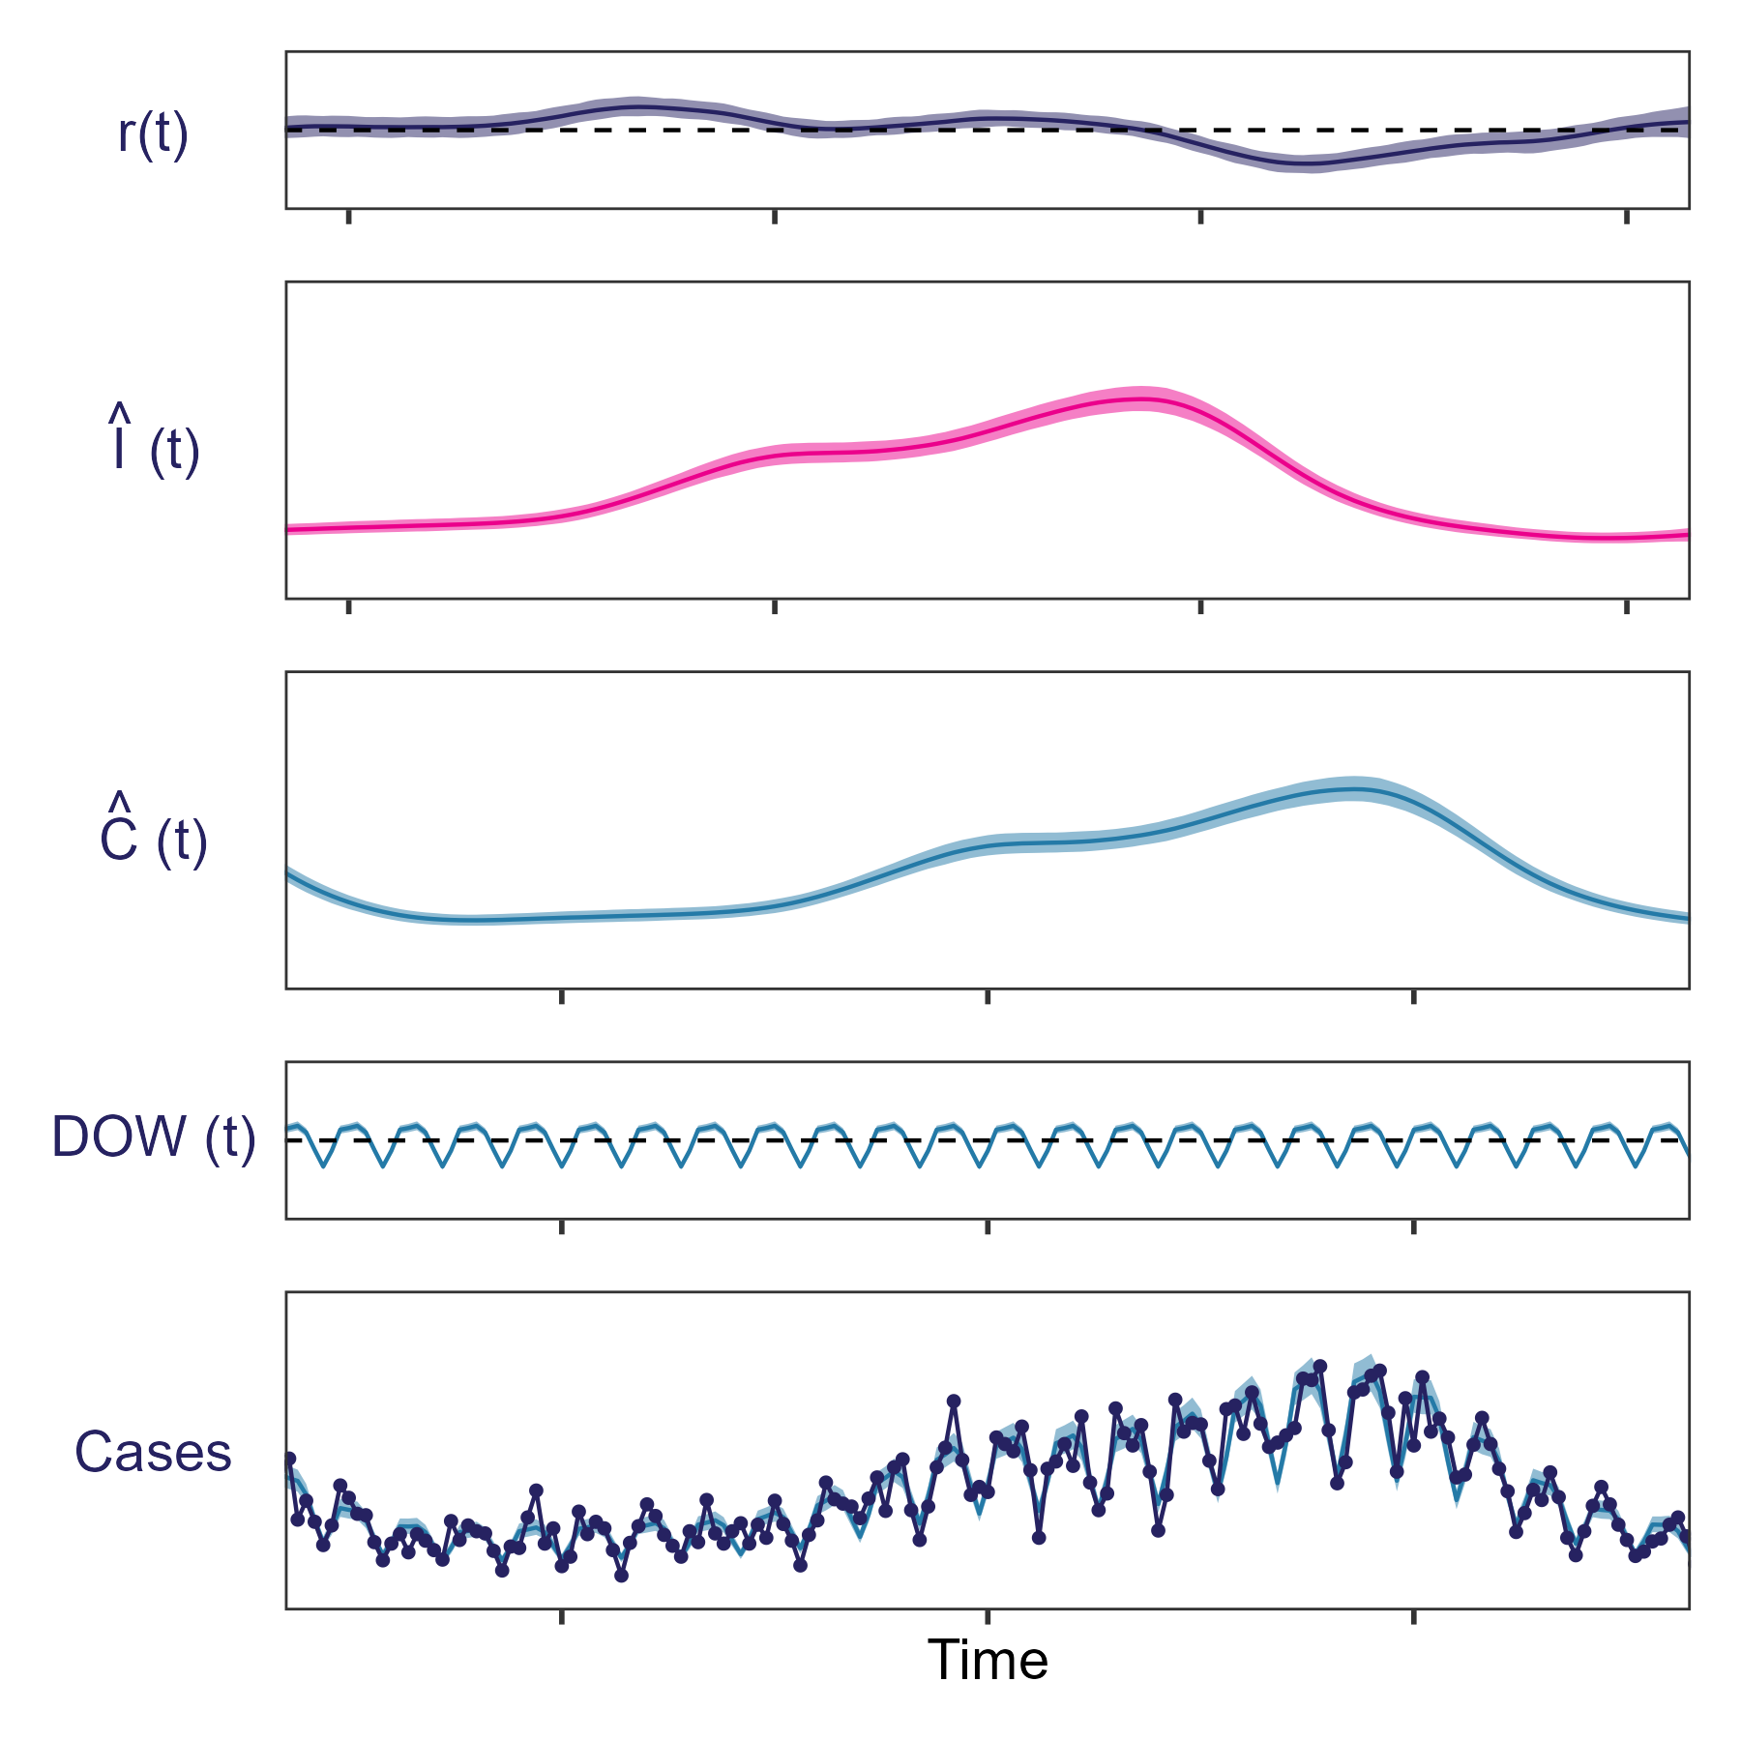
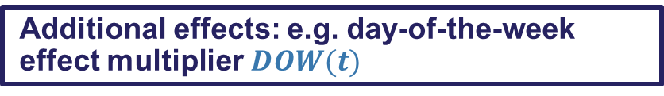
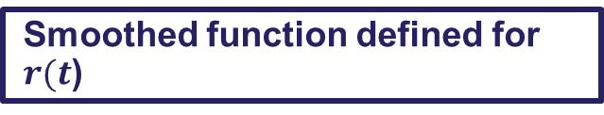


Statistical approaches
Smoothed function defined for $r(t$)
Calculate the infection incidence from the growth rate :
$$\hat{I}\left(t\right)=\hat{I}{(t−1)e}^{r(t)}$$
Calculate observed epidemic time series, $\hat{C}\left(t\right),$ from $\hat{I}\left(t\right)$ using a delay distribution:
$$\hat{C}\left(t\right)=\sum_{τ=0}^{∞}{\hat{I}\left(t−τ\right)p\left(τ\right)}$$
Additional effects: e.g. day-of-the-week effect multiplier$DOW(t)$
Probability of data given modelled values
24

Slide 25




Quantifying delay distributions
$$C\left(t\right)=\sum_{τ=0}^{∞}{I\left(t−τ\right)p\left(τ\right)}$$
To account for delay distributions, we need to know the delay distribution, $p(τ)$
Data is often collected that can be used to quantify delay distributions. For example, data describing the time between different outcomes for individuals:
Time between symptom onset and case identification
Time between identified case and hospitalisation
Time between case and death
Probability distributions can be fit to such data and used when estimating $R_{e}(t )$ or $r(t)$:
Published estimates from other countries may also be applicable to the local context.
Incubation period (time between infection and symptom onset)
Histogram of times from infection to outcome

Slide 26
Biases when quantifying delay distributions
There are biases to look out for when estimating delay distributions
The exact time of events might not be known. For example:
Time of infection might not be known
An individual might not recall exactly when symptoms started
Missing values or censored values can be taken into account in statistical analyses
But they must be recorded
Case number | Symptom onset date (earliest) | Symptom onset date (latest) | Date of case notification
1 | 2-February-2025 | 5-February-2025 | 7-February-2025
2 | Not symptomatic | Not symptomatic | 9-February-2025
3 | MISSING | MISSING | 10-February-2025
4 | 11-February-2025 | 11-February-2025 | 12-February-2025

Slide 27




Biases when quantifying delay distributions
There are biases to look out for when estimating delay distributions
Longer times from infection to outcomes (hospitalisation, death) are less likely to have been observed i.e. right-censoring.
This can bias estimates of delay distributions to shorter times.
Histogram of times from infection to outcome
Not yet observed
Patient 1:
Data collection
Patient 2:
Infection
Case identified
Hospitalisation
Time
Notes:
Delay distributions can also vary over time.
Contact tracing can reduce time to detect cases
Vaccination may change time to severe outcomes
Hospitals may change criteria for admission over time

Slide 28

Practical
In today’s practical we will:
Estimate $R_{e}(t)$ and $r(t)$ using a statistical model (implemented in EpiNow2)
Compare estimates of $R_{e}(t)$ and $r(t)$ made:
Using different assumed GI distributions
Using different datasets
Using different datasets correcting for delays

Slide 29
BLANK SLIDE

